Slide 1

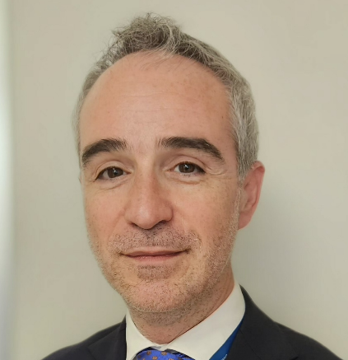
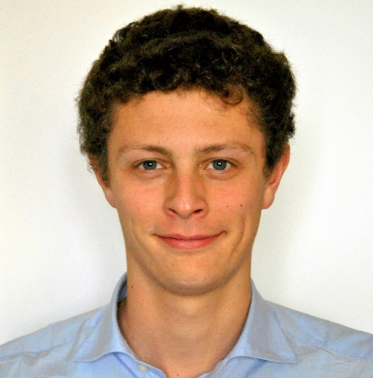
Regional Airports
Conference & Exhibition
Farming Hydrogen with TULIPS at Torino Airport
Lorenzo Gusman
COO
SAGAT Torino Airport
Gabriele Restaldo
Carbon Management and Energy Innovation
SAGAT Torino Airport
Turin, Italy
April 28th 2025

Slide 2

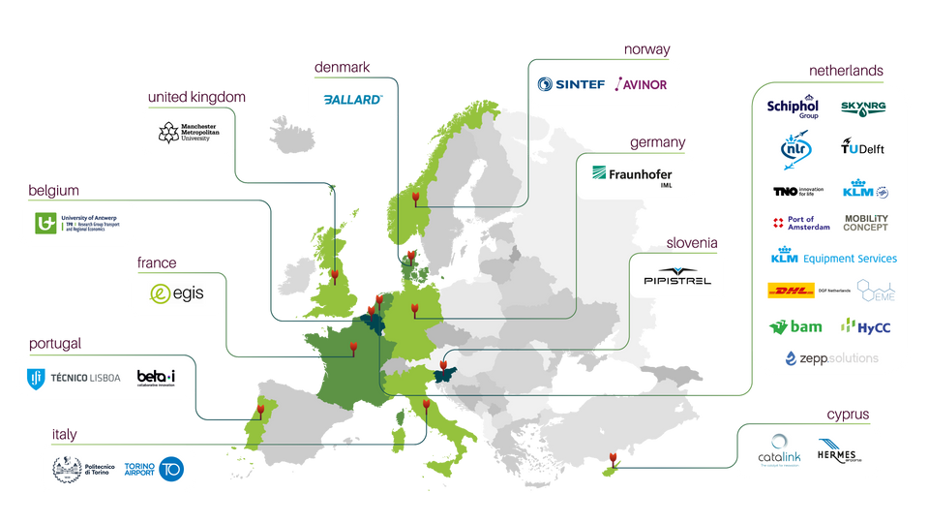
An Ideal Context for Sharing Ideas
Joining the Efforts of the Different Players of the Industry is the Winning Choice
SCHIPHOL
62M pax
OSLO
25M pax
Sustainable Technologies of Aviation
In 2021 Torino Airport joined the TULIPS consortium together with the Airports of Schiphol (the lighthouse), Larnaca and Oslo.
Together with 30 partners from every aviation sector, we took up the challenge to speed up the roll-out of sustainable technologies in aviation and significantly contribute towards the zero emissions and zero waste airports by 2030 and climate-neutral aviation by 2050
Four very different airports, located different locations in Europe from the big hub to the regional airport, partner together to bring different experiences in a wide span of activities.
TULIPS is a virtuous example of integration and exchange of ideas between multiple contexts and stakeholders in the aviation industry
TORINO
5M pax
LARNACA
12M pax

Slide 3



DemonsTrating lower pollUting soLutions
for sustaInable airPorts acrosS Europe
  How the Airports are Preparing for the Future Aviation
WP4
Zero Emissions
Airside Operations
WP2
Energy Supply of
Future Aircraft
WP3
H2
WP7
Smart Airport
Energy Hub
Green Air and Land
WP1
WP6
Sustainable Inter-modal Transport Connections
LH2
Circular Airports
WP5
Scaling Up The
SAF Market
  Zero Waste & Zero Airport Emissions in 2030
  Net Zero Aviation Emissions in 2050
TULIPS Main Objective:
Accelerate emission reduction and the efficient resource use at airports in Europe 2030/50.
Demonstrate, measure and prescribe innovative technologies and concepts that can support the ongoing transition towards sustainable airport operations (green airports)
Develop sustainability roadmaps based on evidence from 7 focus areas with a total of 17 demonstrations.

Slide 4

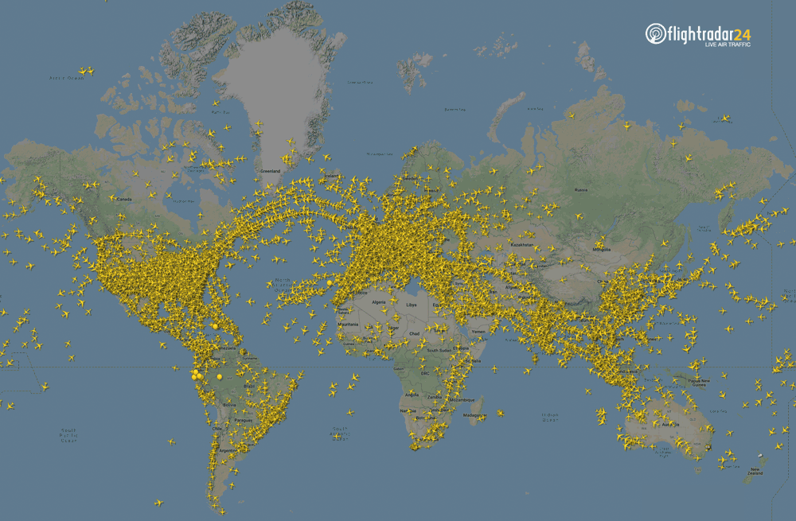
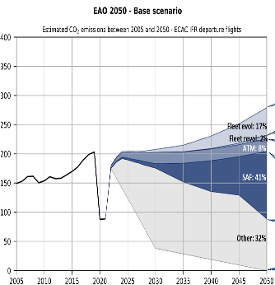
Decarbonization and the Aviation Industry
Passenger share
European Airports by size
A Challenge for every Category of Airport
< 5 mln 11%
>40 mln 27%
5-10 mln 14%
25-40 mln 21%
65 million flights
9.8 billion passengers

Slide 5



Turning the green transition into concrete value
Through TULIPS, SAGAT developed the skills to work on R&D with universities and research organizations, creating economic, social and environmental value and stimulating strong interest across the ecosystem.
Funded initiatives:
👉 Attract external funding to accelerate strategic investments
👉 Enable real innovation (energy, decarbonisation, operations)
👉 Strengthen skills and reputation
👉 Multiplies SAGAT’s investment
To obtain:
✦ Sustainable infrastructure
✦ New operational technologies
✦ European partnerships
✦ The ability to anticipate the future of air transport
Projects build the future.
Project portfolio:
6 Millions/euro
Funded projects:
2 Millions/euro
Projects in the pipeline:
1,2 Millions/euro

Slide 6


Slide 7
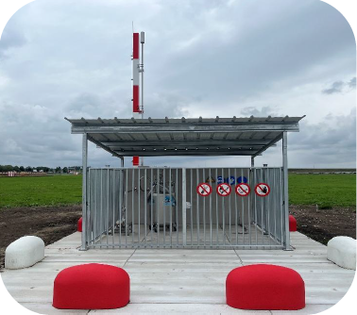
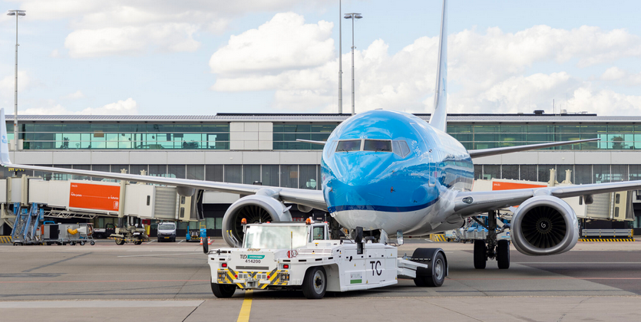
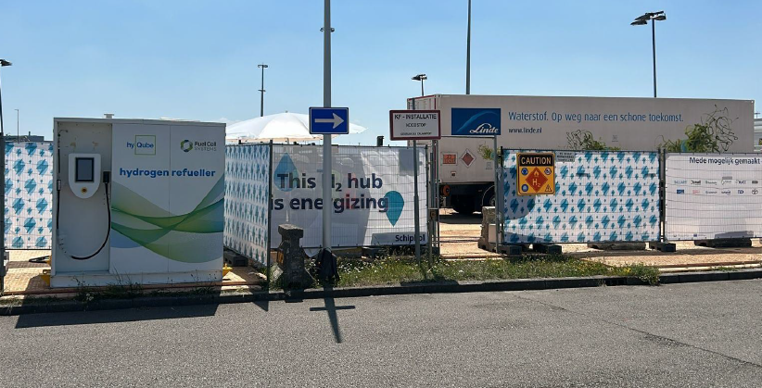
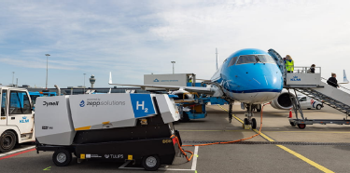
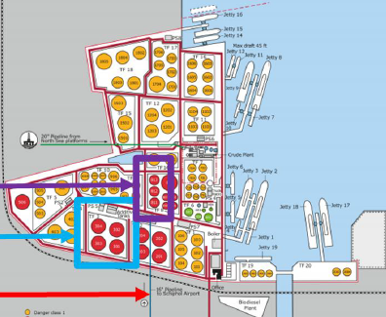
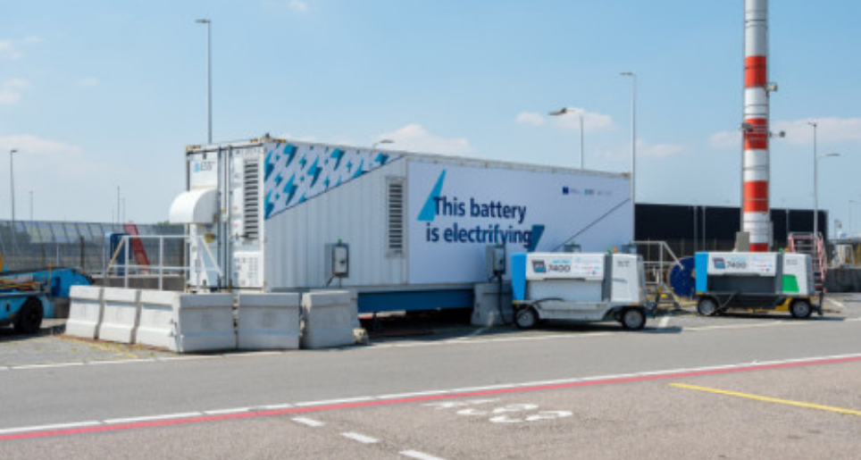
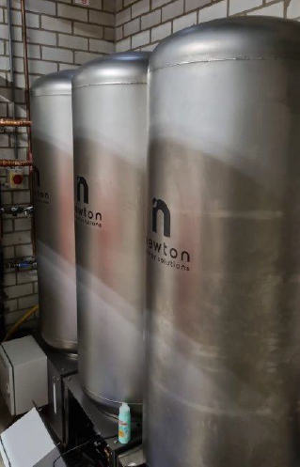
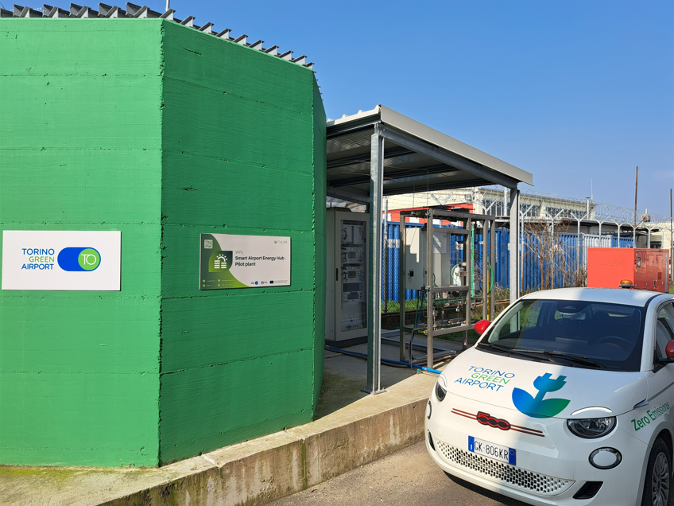
TULIPS´ambitious targets to diversify the resources
Demos and Pilot Plants at Various Airports
Zero emissions airside:
H₂-tow tractor
Zero emissions landside: gaseous H₂ refueller
Sustainable energy supply and logistics: LH₂ storage facility
Zero emission handling equipment: H₂-GPU
Stimulate SAF
for aviation: large scale SAF blending
Smart grid solutions: Iron flow battery
Smart grid solutions: heat battery solution
Smart grid solutions: green H₂ production and storage

Slide 8













The Airport at the Heart of Synergies towards Decarbonization
Decarbonization of Aviation is Something we will Achieve through Collaboration rather than Competition
ENERGY COMP.
ATC
AIRLINES
FUELLERS
PASSENGERS
MANUFACTURERS
HANDLERS

Slide 9
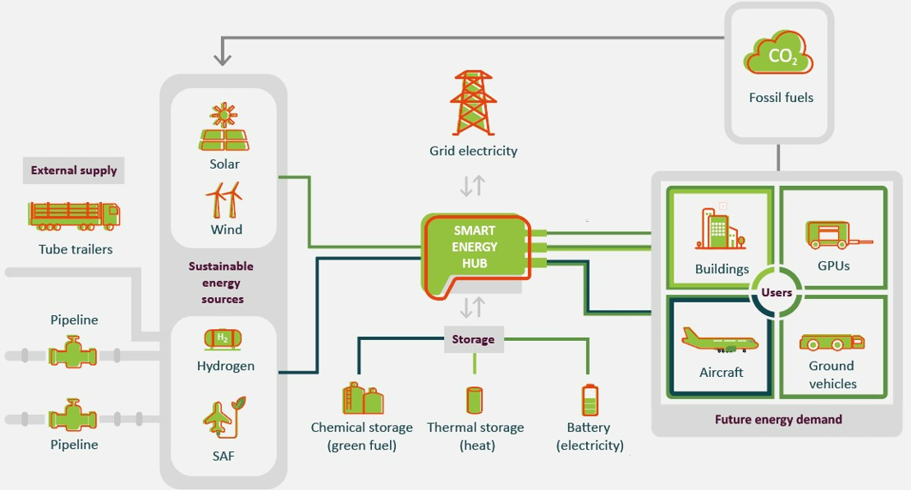
Smart grid concept

Slide 10
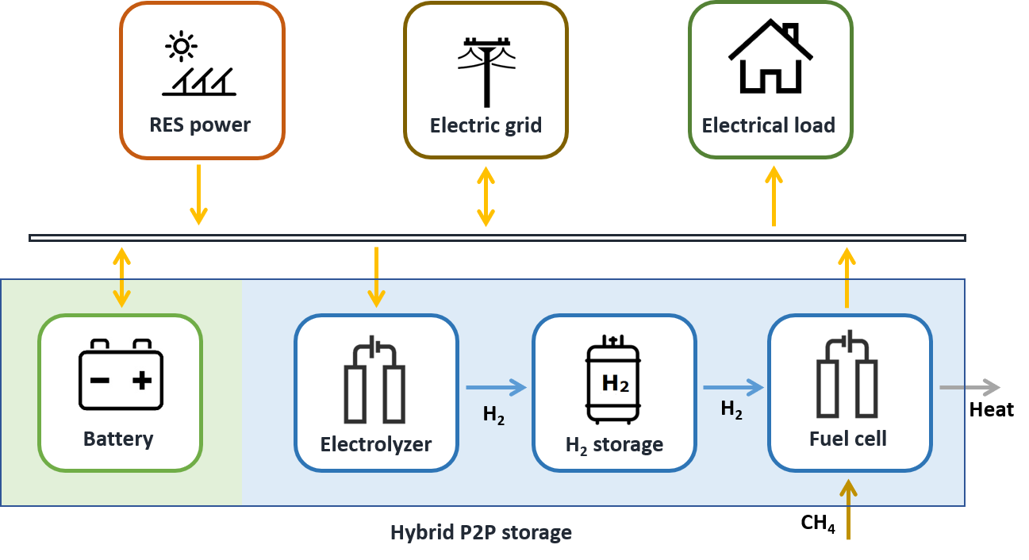
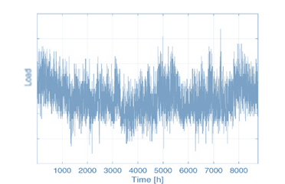
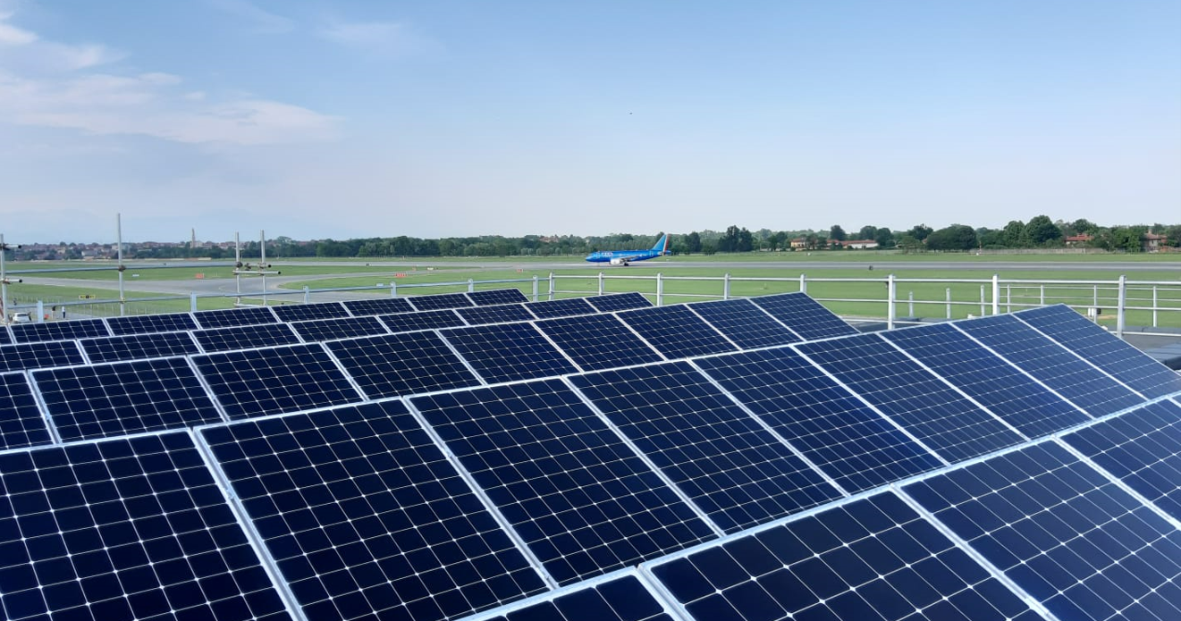

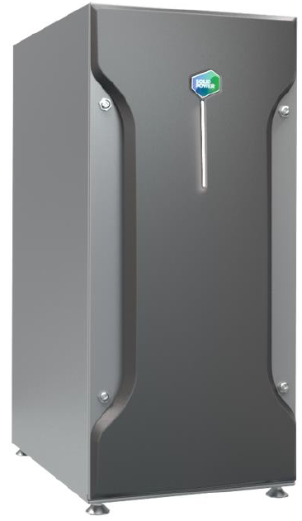

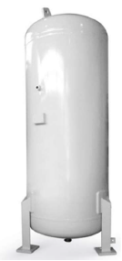
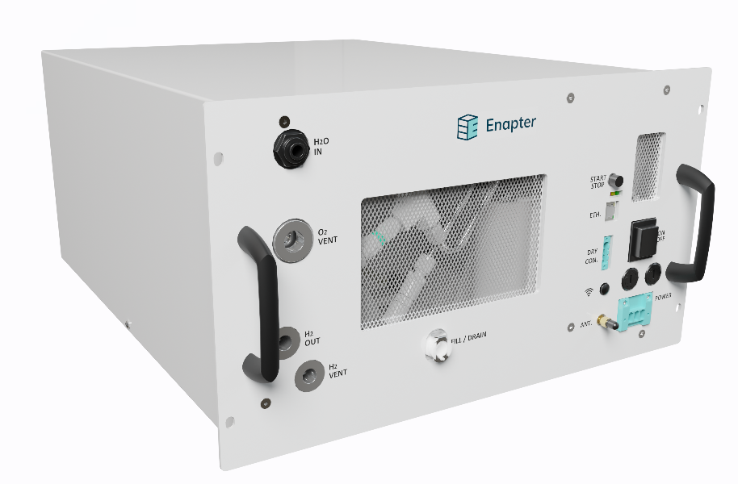
Smart grid concept: the fire brigade pilot
  PV PLANT: 83,6 kWp
  ELECTRICAL LOAD
  FIRE STATION: 30 kW
  FUEL CELL
  POWER: 3 kWe
  N. 7 CAR BATTERY CHARGERS: 7,5 kW EACH
  ELETTROLYZER FLOW RATE ~ 1 Nm3/h
  STORAGE:
  VOLUME ~ 0,4 m3
  PRESSURE ~ 30 bar

Slide 11
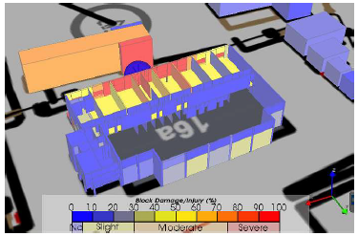
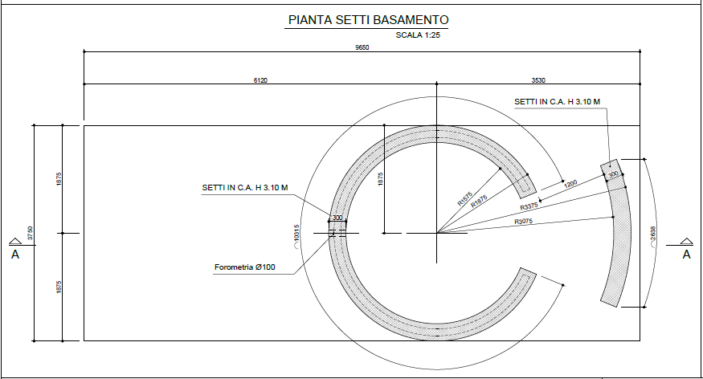
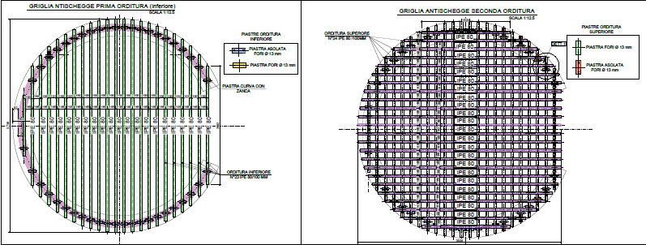
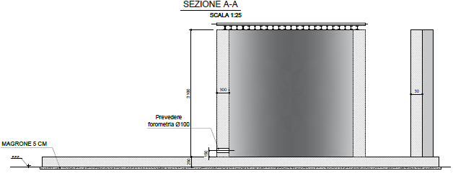
Design phase
Requirements and compromises between regulatory framework and installation needs
When starting the project, there was not a specific legislation on hydrogen storage in Italy: a reference could be found on hydrogen fuel stations regulation (DM 23/10/2018) and on regulation on methane storage (DM 3/2/2016);
A Risk Analysis on the introduction of a hydrogen storage inside airport grounds has been performed. The risk analysis has considered the storage as a key risk and it has been put in relation with the other key risks already present (an existing gasoline storage) and civil buildings that have to be preserved in case of accident (fire station and chopper track in the near premises);
The main risk considered is the jet fire deriving from a leakage;
The following mitigation measures have been identified:
    Explosion-proof ceiling
    Steel reinforced concrete septum and cage of 30 cm thickness

Slide 12
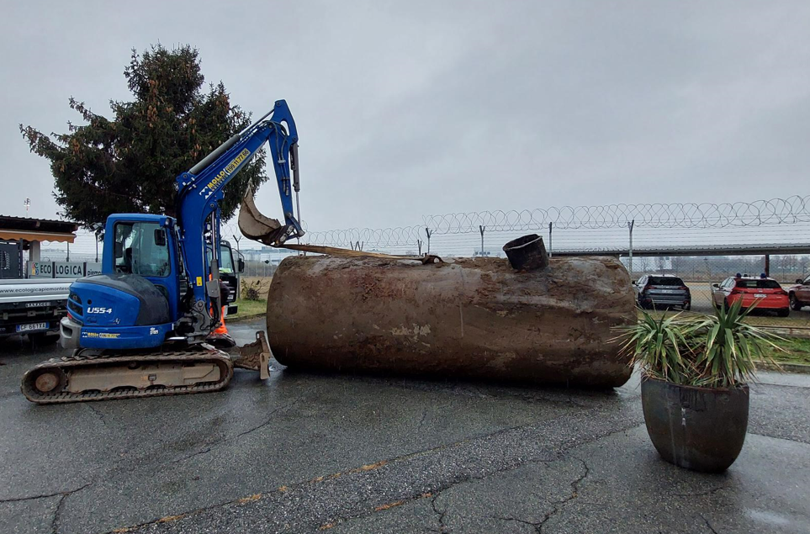
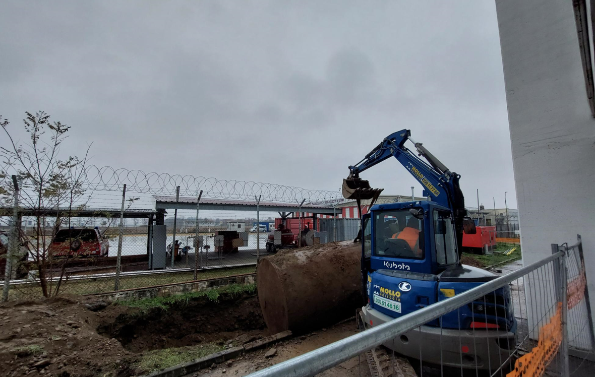
Implementation and start up of the system
PREPARATION (VESSEL REMOVAL)
(dec 2023)

Slide 13
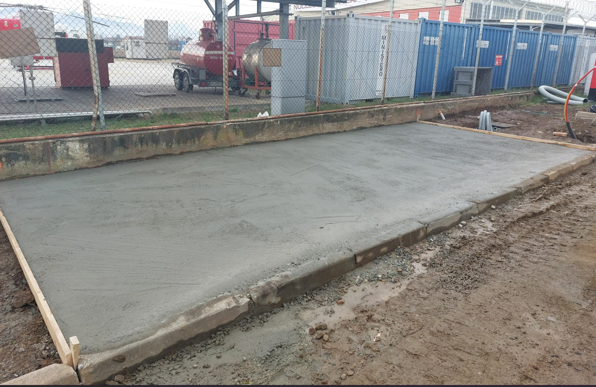
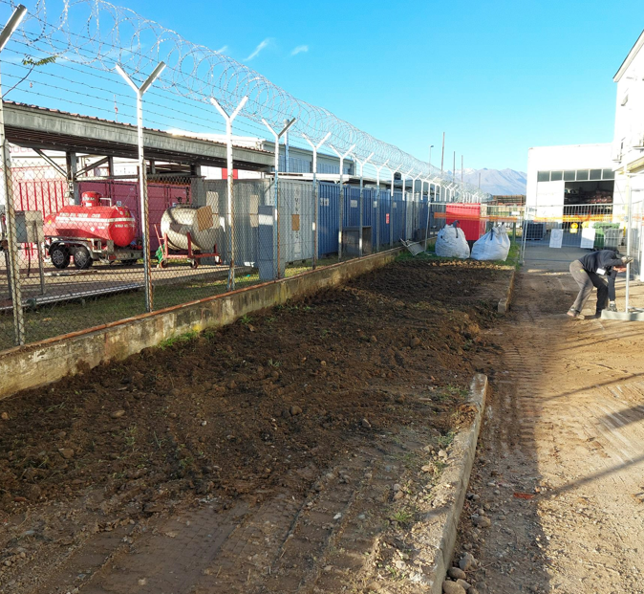
Implementation and start up of the system
PREPARATION (VESSEL REMOVAL)
(dec 2023)
CONCRETE FOUNDATION
(jan 2024)

Slide 14
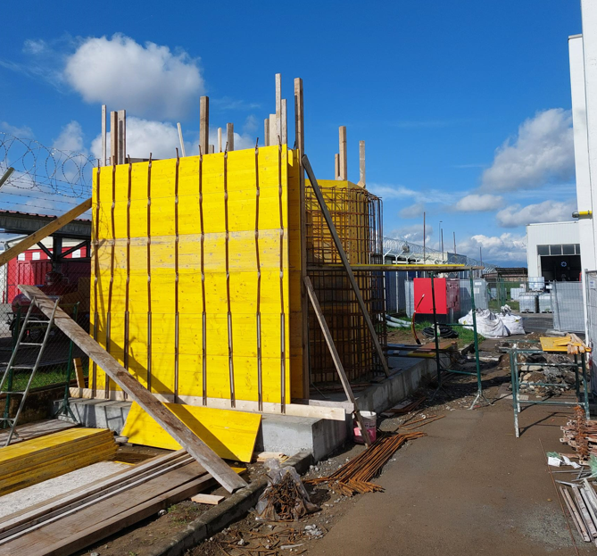
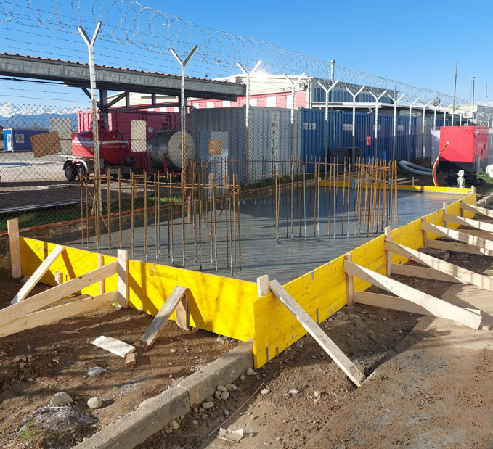
Implementation and start up of the system
PREPARATION (VESSEL REMOVAL)
(dec 2023)
CONCRETE FOUNDATION
(jan 2024)
REINFORCEMENT STRUCTURE
(jan 2024)

Slide 15
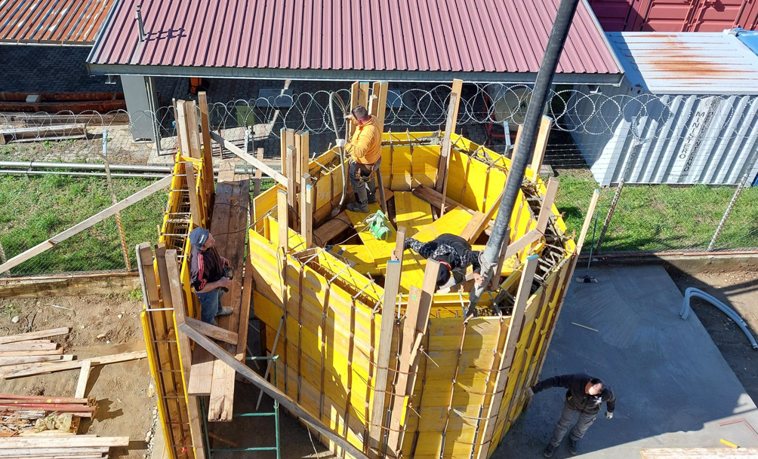
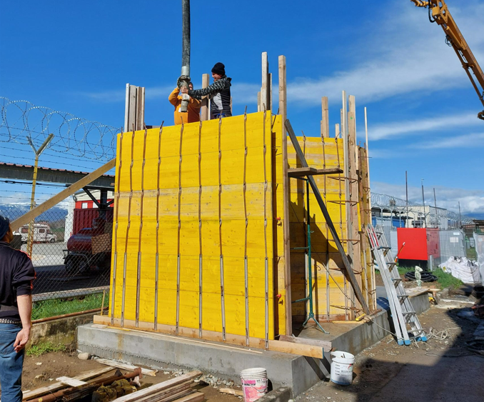
Implementation and start up of the system
PREPARATION (VESSEL REMOVAL)
(dec 2023)
CONCRETE FOUNDATION
(jan 2024)
REINFORCEMENT STRUCTURE
(jan 2024)
CONCRETE CASTING
(feb 2024)

Slide 16
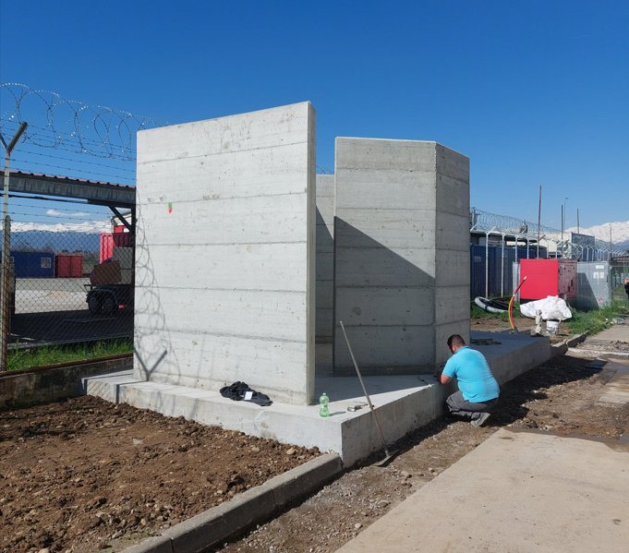
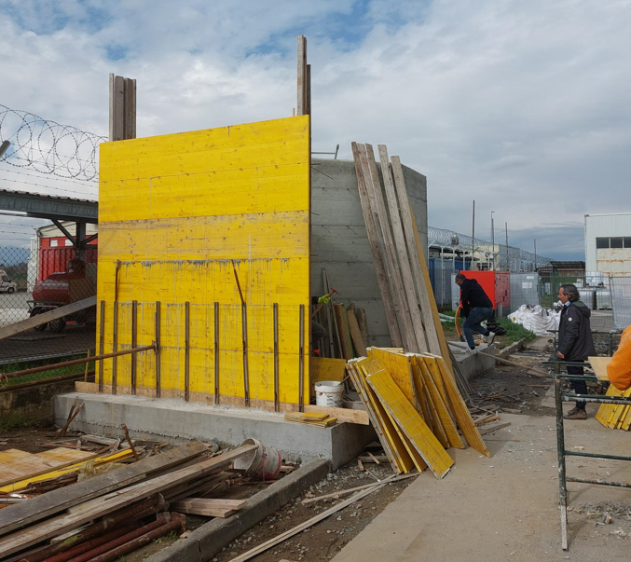
Implementation and start up of the system
CREATION OF THE CONCRETE SEPTUM
(feb 2024)

Slide 17
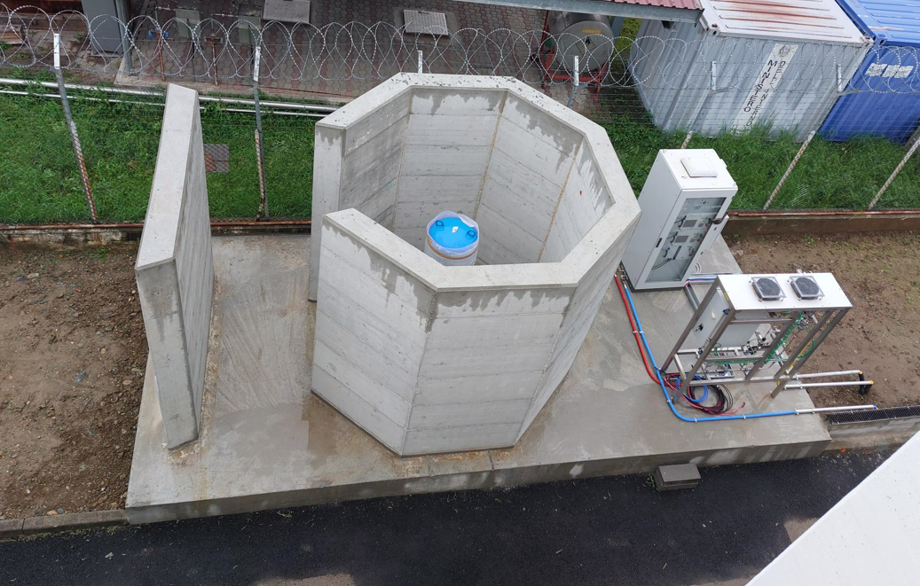
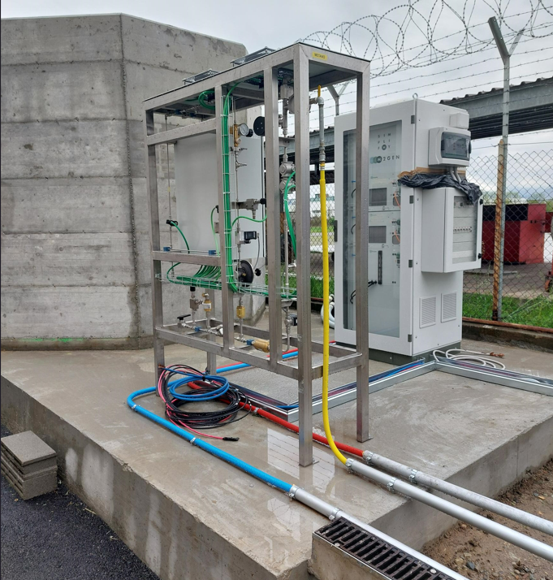
Implementation and start up of the system
CREATION OF THE CONCRETE SEPTUM
(feb 2024)
CONNECTION OF DEVICES AND TESTING
(mar 2024)

Slide 18
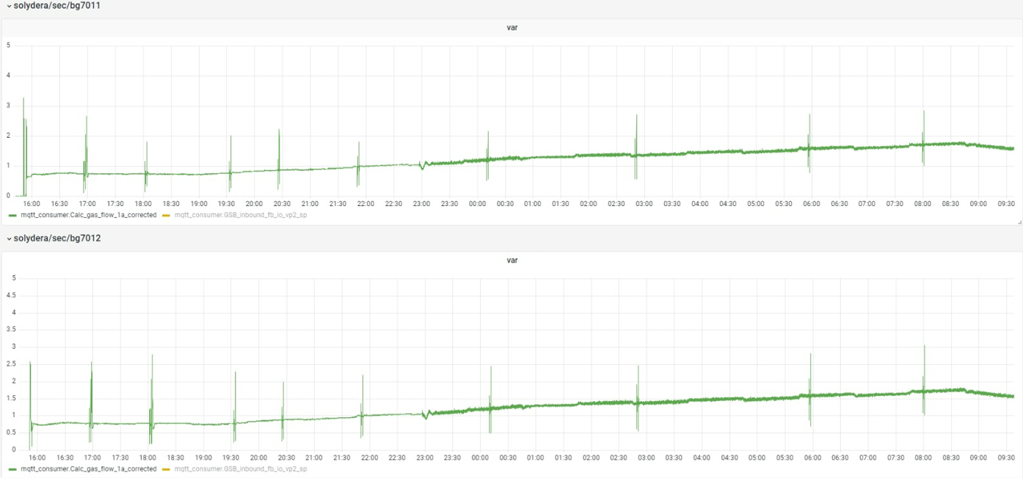
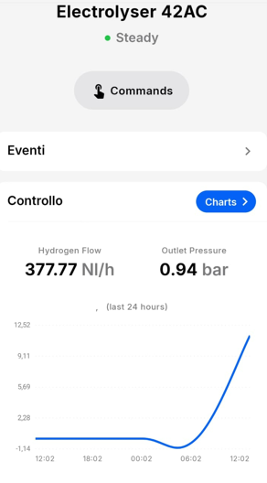
Implementation and start up of the system
CREATION OF THE CONCRETE SEPTUM
(feb 2024)
CONNECTION OF DEVICES AND TESTING
(mar 2024)
TESTING OF EACH COMPONENT
(jun-sep 2024)
START OF TESTING PLAN

Slide 19
Implementation and start up of the system
CREATION OF THE CONCRETE SEPTUM
(feb 2024)
CONNECTION OF DEVICES AND TESTING
(mar 2024)
TESTING OF EACH COMPONENT
(jun-sep 2024)
START OF TESTING PLAN

Slide 20





System operation highlights
150 kg of hydrogen produced
More than 3.500 hours of electrolysers’ operation
More than 10.000 hours of operation on the two Fuel Cell stacks
30 MWh of electricity produced by the Fuel Cells
320 MWh of electricity produced by the PV plant

Slide 21




Operational challenges and hurdles
Component
Issues
Lessons learned
Robustness
Reliability of components is crucial, and extraordinary maintenance very expensive
The contract for the ordinary maintenance has to be well structured in order to reduce the Mean Time to Repair and unexpected expenses
Electrolyser
The mass flow controller is a critical component with high repair and delivery times
The type of flow controller has to be carefully selected according to the purity level of H₂
Blending unit
Very sensitive to outages (T gradients) and pressure fluctuations
A key is to have a reliable assistance with remote supervision to prevent damages, the design phase of the fuel line is very important
Fuel cell
The system is not so flexible once defined
Number of parameters and frequency has to be carefully designed before operation. A flexible system is a plus, but it has to be cost effective
Supervision system

Slide 22
Conclusions and take-home messages
First-of-its-kind experimental campaign of an SOFC unit in an airport environment
Wide modulation range (30-100% of rated power), high efficiency and flexibility on fuel mixtures is a plus, when compared to other state of the art solutions
The SOFC rated efficiency remains above 52% even when fed with high H₂ concentration and low loads
Safety countermeasures have to be carefully analysed before implementing H₂ solutions
Flexibility is crucial to reach the decarbonisation target
Key role of airports as energy hubs to integrate different sources and foster decarbonisation in the aviation sector

Slide 23
Thank you for your attention

