Slide 1



Innovation that scales: Impactful projects from Aena’s Regional Airports
Pablo Lopez
Head of Ideation & Entrepreneurship
RACE 2026

Slide 2




Aena: The world’s largest operator by number of passengers
Verde
RGB: 150/206/0
WEB: #96CE00
Notes:
Aena is the world’s largest airport operator by number of passengers, managing a network of 46 airports and 2 heliports in Spain, along with 32 airports internationally, including Mexico, Brazil, Jamaica, and the United Kingdom. In 2025, our network handled 453 million passengers, demonstrating the scale of our global operations and the strength of our airport model.
Our strategy is driven by three pillars: delivering excellence in passenger services, advancing our Strategic Plan for Innovation and Digital Transformation, and leading the industry in sustainability. We are firmly committed to becoming Net Zero Carbon by 2030, with 19 airports reaching Level 4+ Airport Carbon Accreditation by 2026, and progressing toward Level 5 by 2030.

Slide 3
Key Insights You’ll Take Away
1
2
3
4
Innovation Strategy & Programs
Use case 1: Smart Guidance System
IBZ airprot
9.1 Mpax
Use Case 2:
Drone Management Platform
HSK airport
1 Kpax
Use Case 3:
Remote Passenger Jet Bridges
SVQ & VGO airports
9.6 & 1.1 Mpax

Slide 4









Vision – values
Towards an autonomous, sustainable and personalized airport
STRATEGIC LINES
PROGRAMS & TOOLS
CLIENT EXPERIENCE
Aena Ventures
Innova Program
AUTONOMOUS AIRPORT
Tech Surveillance
Collab.
Agreements
NEW OPPORTUNTIES
International groups
SUSTAINABILITY
RACE 2026
Notes:
Our innovation approach is centered on transforming airports into fully autonomous and intelligent ecosystems. To achieve this, we work across several key areas: enhancing the passenger experience, capturing and analyzing operational data to better monitor our processes, streamlining and automating activities, and exploring new business opportunities.
Sustainability is also fundamental, guiding how we design and deploy every new solution.
And underpinning all of this is our connectivity layer. A connectivity layer is essential for achieving an autonomous airport because it enables all systems, sensors, and actors to operate in real-time coordination, ensuring safe and efficient automated decision‑making.
So any initiative that helps us expand knowledge, improve cost efficiency, or unlock new revenue streams becomes a strong candidate for validation within this ecosystem.”

Slide 5
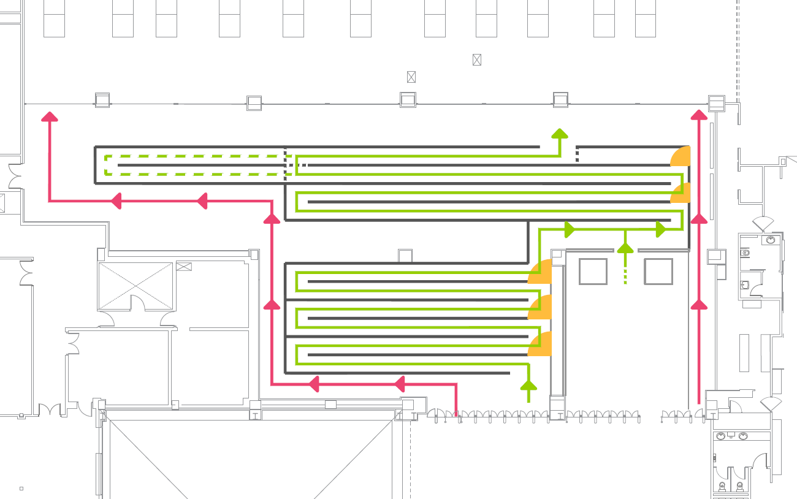

Use Case 1 – Smart Guidance System
Ibiza Airport – 9.1 Mpax
TRIAL
NEXT STEPS
Roll-out to other Aena airports, starting with the more seasonal ones that experience very high traffic during the summer season
Ibiza
Malaga
Alicante
Menorca
Operational efficiency improvement
Reduction in processing time
% pax
< 2 min
% pax
< 4 min
Changes / day
- 40 seg
+ 10%
+ 15%
~ 170
RACE 2026

Slide 6
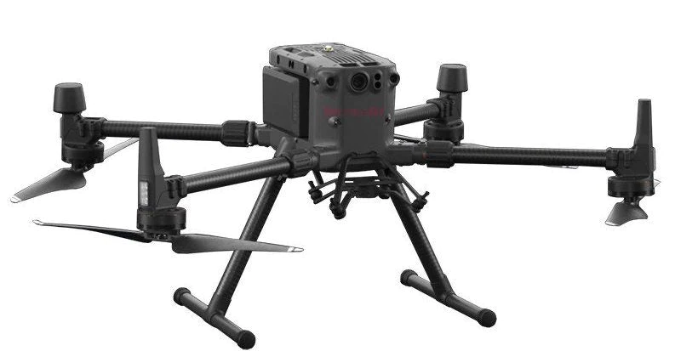
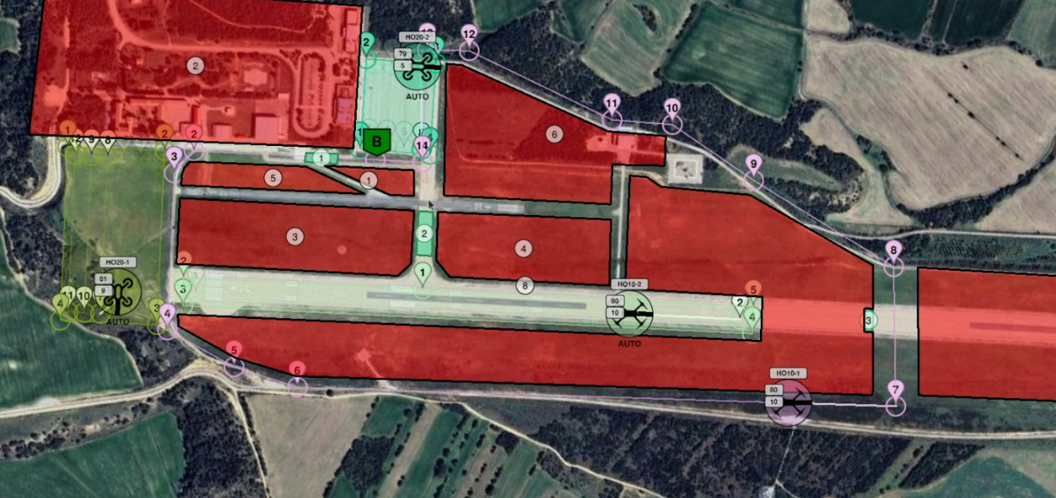
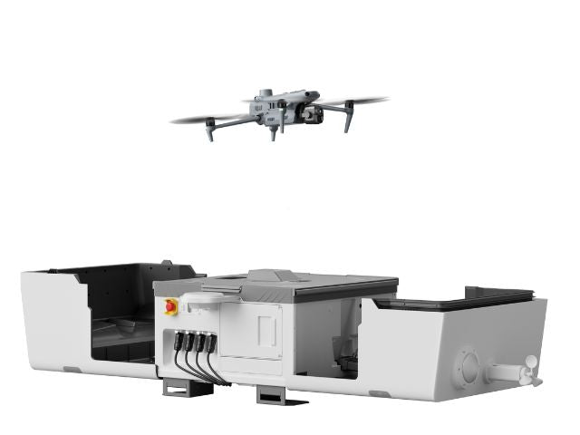
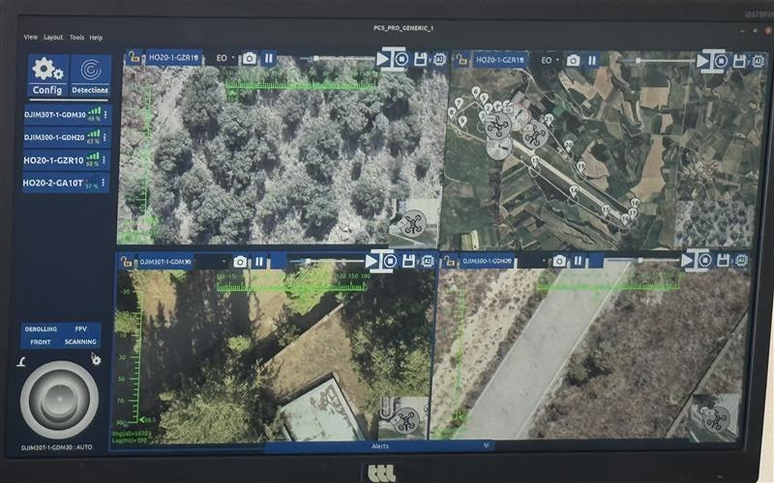
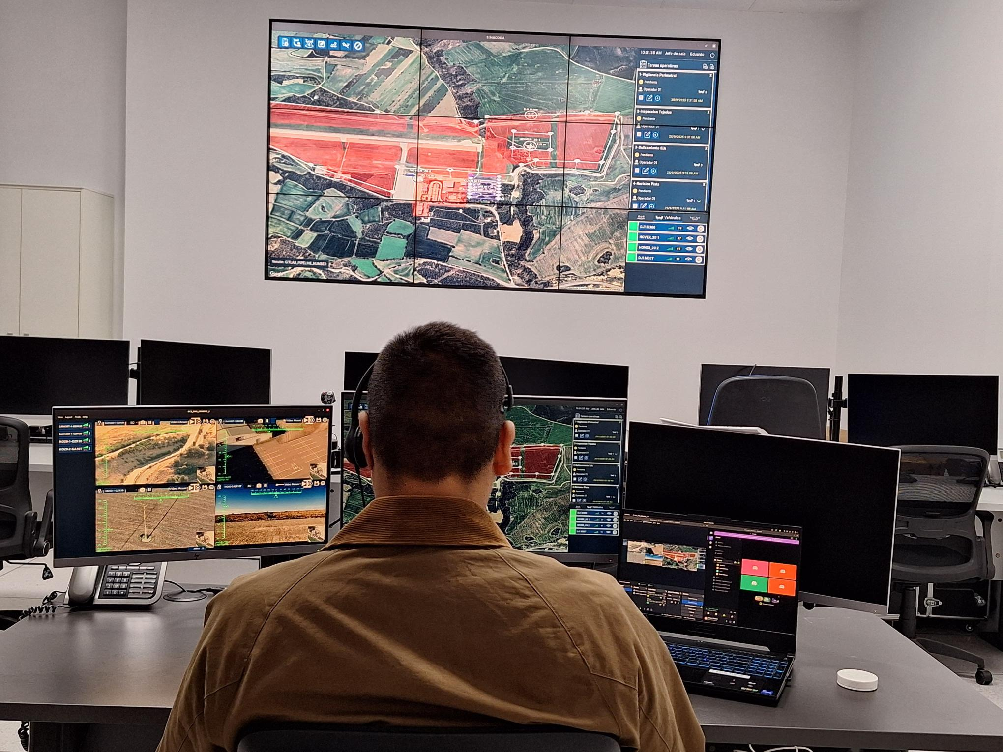
Use Case 2 – Drone Management Platform
Huesca Airport – 1Kpax
TRIAL
NEXT STEPS
Missions carried out
Enabler to continue developing drone use cases at airports.
Next project: autonomous airport perimeter surveillance using drones and drone nest systems at SCQ.
  Drone 1: Airport perimeter inspection
  Drone 2: Runway visual inspection
  Drone 3: Approach lighting inspection
  Drone 4: General infrastructure inspections (roofs, towers, facilities, etc.)
RACE 2026

Slide 7
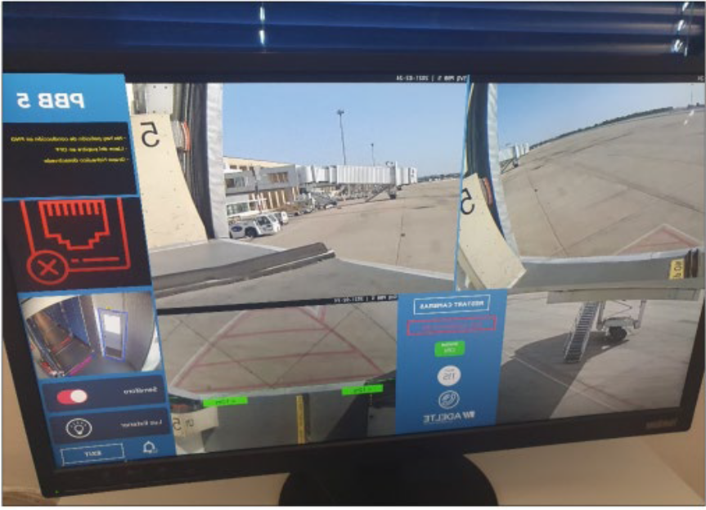
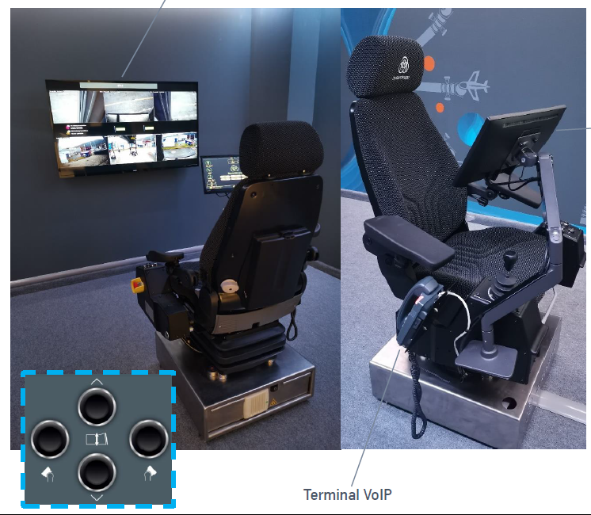
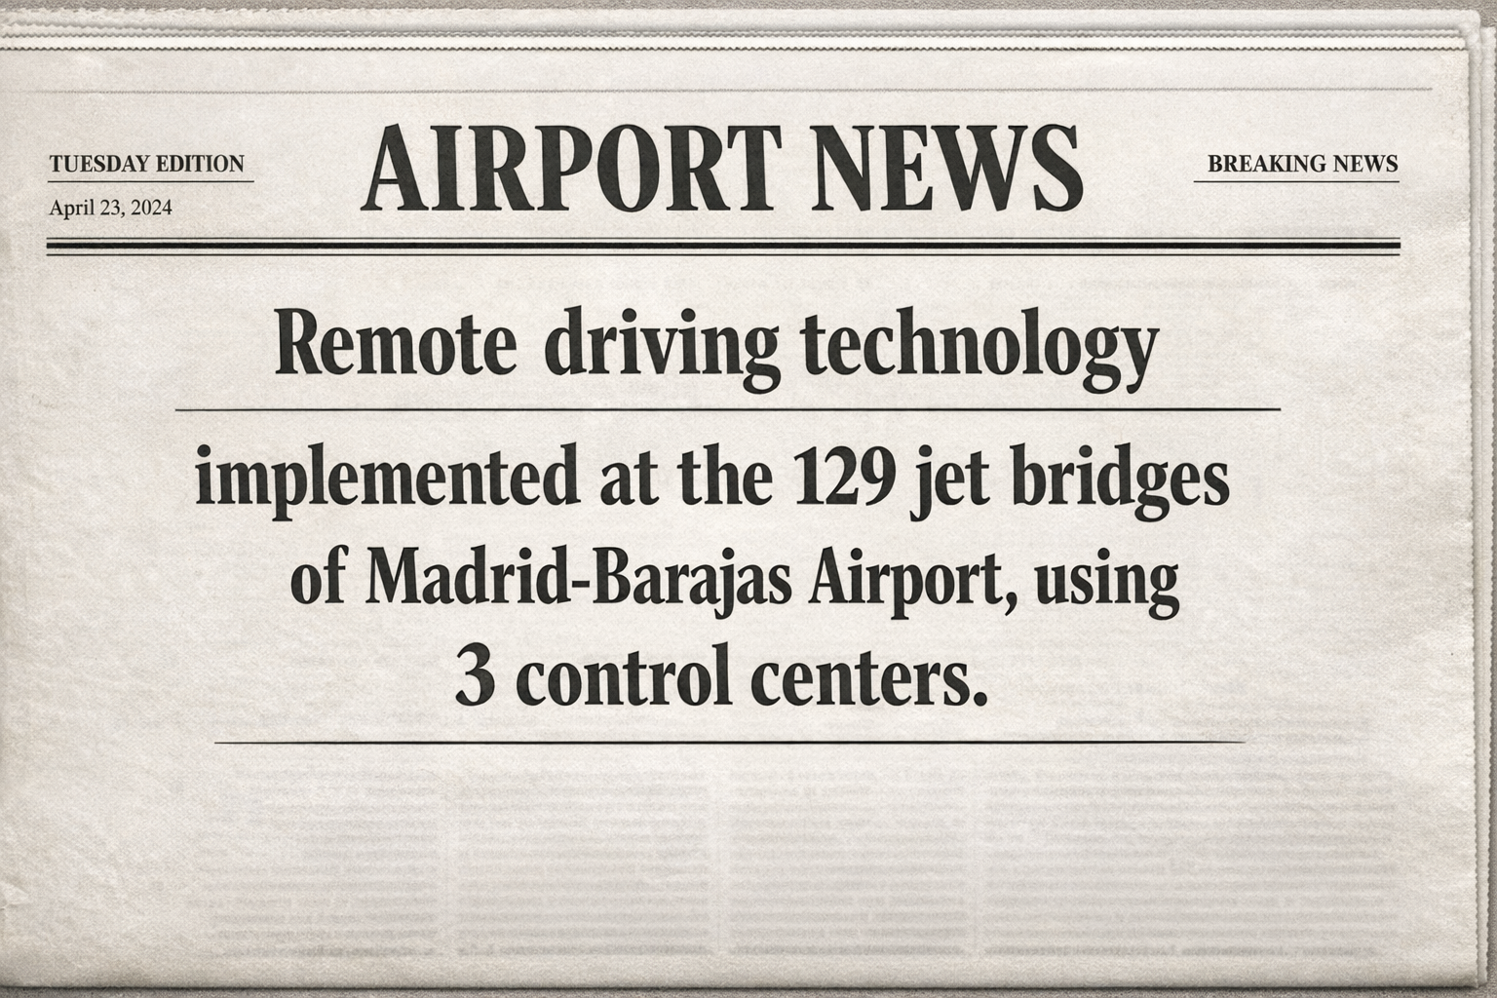
Use Case 3 – Remote Passenger Jet Bridges
Vigo (1.1 Mpax) & Seville (9.6 Mpax) Airports
TRIAL
NEXT STEPS
Roll out to other Aena airports
Phases
Remote Jet Bridges control
Seville Airport
External Remote Control
Vigo Airport
Automatic Docking
Vigo Airport
RACE 2026

Slide 8



Thank you
Company committed to the United Nations Sustainable Development Goals (SDGs)

