Slide 1
Torino Airport Ground Trasportation Dashboard
ACI EUROPE RACE 2026 | Dragon’s Den: Regional Airports x Innovation
28 April 2026

Slide 2
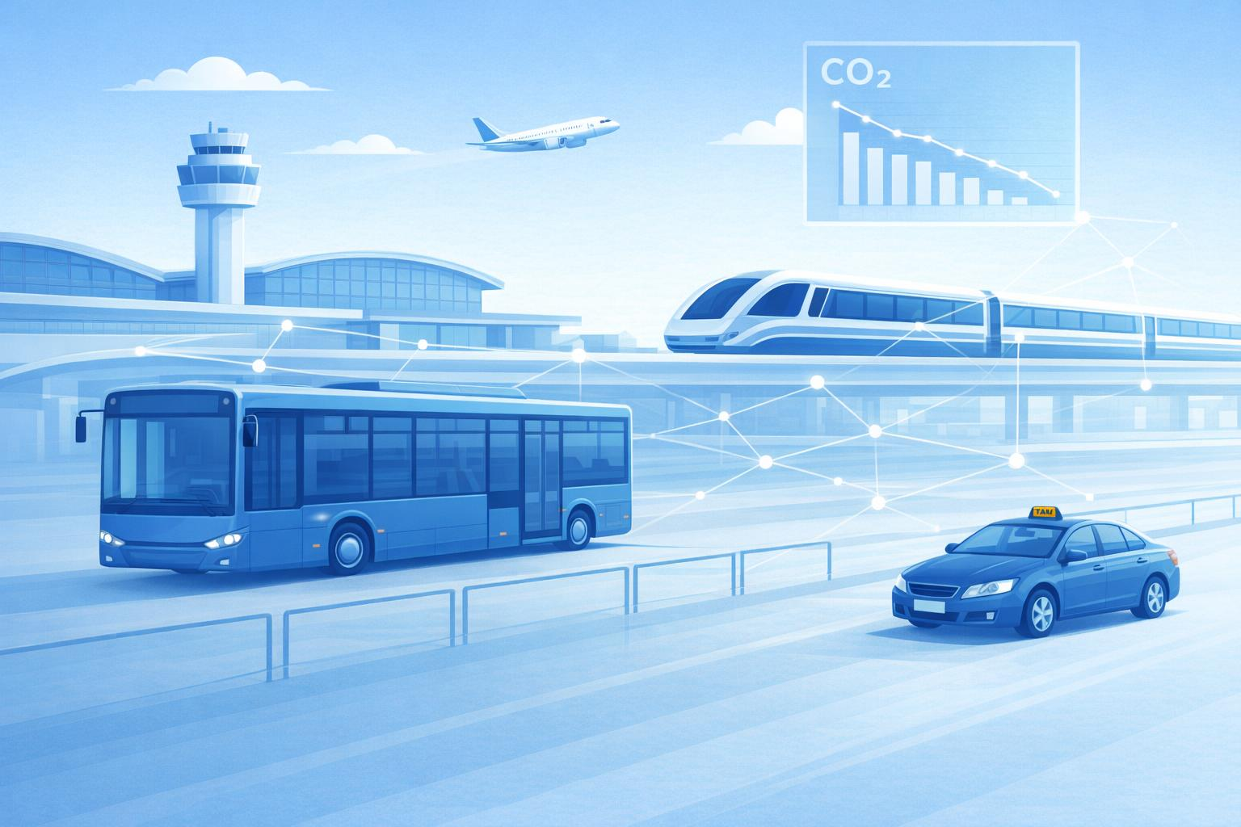
Torino Airport Ground Transportation
For regional airports, ground transportation is no longer just an operational topic.
It is a strategic lever for sustainability, passenger experience and airline attractiveness.
Why it matters:
Ground transportation = major Scope 3 emissions
Weak intermodality limits catchment area and growth
Decisions are often made without reliable data.

Slide 3
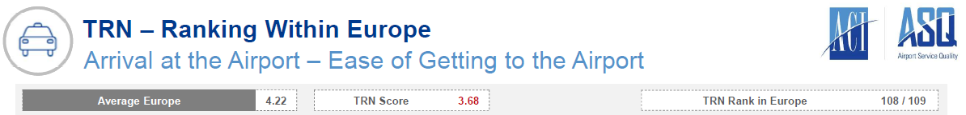
The challenge
In 2022 Torino Airport was positioned at the lower end of the ASQ ranking among European airports
Limited visibility on how passengers reached the airport
No objective measurement of:
  Modal split
  Expected impact of the new rail connection scheduled to open in January 2024
  CO₂ emissions from ground access.
Key line: We could not improve what we could not measure.

Slide 4

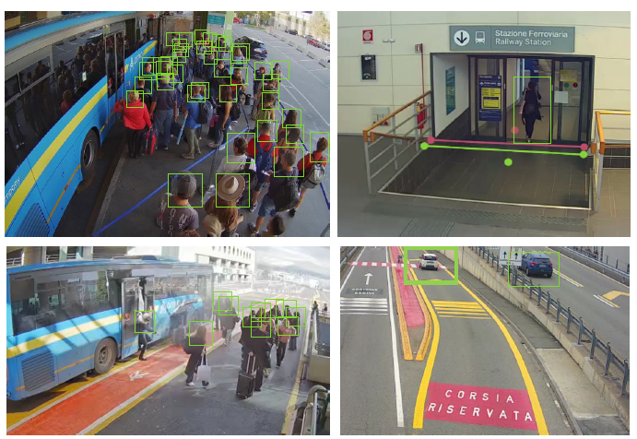
The solution
A Ground Transportation Dashboard powered by AI
What it does:
Integrates heterogeneous data sources:
  Bus and rail passenger volumes captured through computer vision
  Vehicle flows by mode (taxi, private car, moto, truck) detected via camera‑based video analytics
  Parking, car sharing, limo and shuttle sourced from the parking management database.
Provides real-time and historical insights.
Calculates Scope 3 CO₂ emissions (Airport Carbon Accreditation).

Slide 5
Key challenges addressed
3-year implementation journey
2022
2023
2024
Dashboard development & system integration
Proof of Concept &
AI video analytics
Full operational deployment
Governance & stakeholders:
Established Airport Ground Transportation Committee
Public & private transport operators
Technology partners
Key challenges addressed:
Data accuracy & cross-validation
Emission model assumptions
Privacy by design
Notes:
Privacy by design (passenger notice signage, real‑time analytics with no video storage, GDPR‑compliant).

Slide 6








Results & KPIs
Measured impact:
Passenger experience:
>46% of passengers using collective transport* in 2025 | Clear evidence of rail link impact after January 2024 (from 0 to 16%)
performance
Identification of capacity gaps at peak times and start of a new bus operator since 2023 | Contribution to Airport Carbon Accreditation Level 3+
3.68
4.27
(2022)
(2025)
Unexpected benefits:
Stronger collaboration with operators | Data-driven service adjustments | New non-aviation revenues (advertising & space rentals)
* Considering: train, bus, taxi, limo and car sharing

Slide 7
From road to rail: data‑driven evidence
Market share shift after the rail launch (2023 → 2025)
CO₂ emissions share
2025
✅ Private car drop-off: −10 PP
✅ Bus share stabilised
✅ Collective transport: +11 PP
Impact of new rail link launched January 2024: +16 PP

Slide 8
Thank you.
www.torinoairport.com

