Slide 1

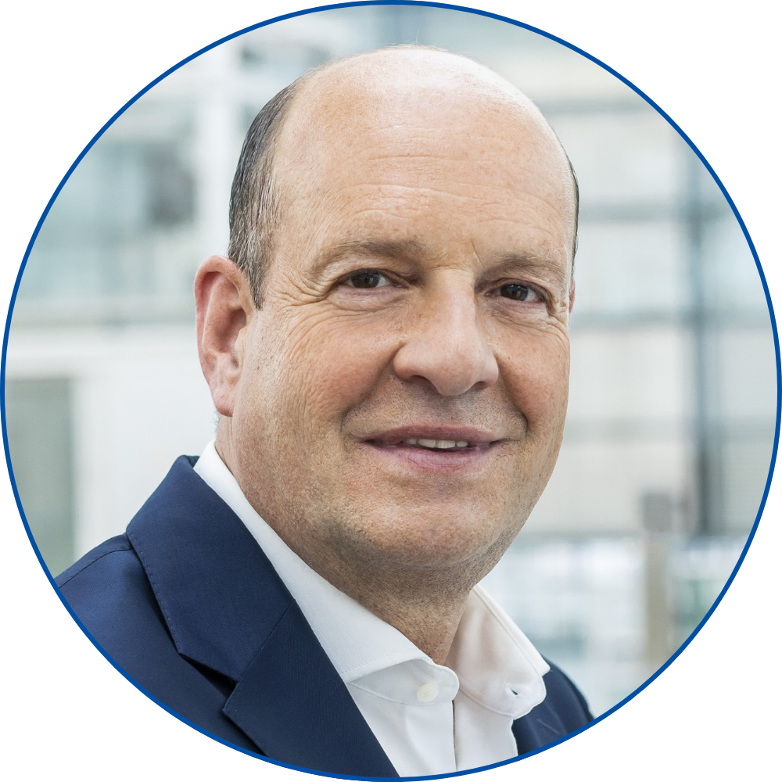
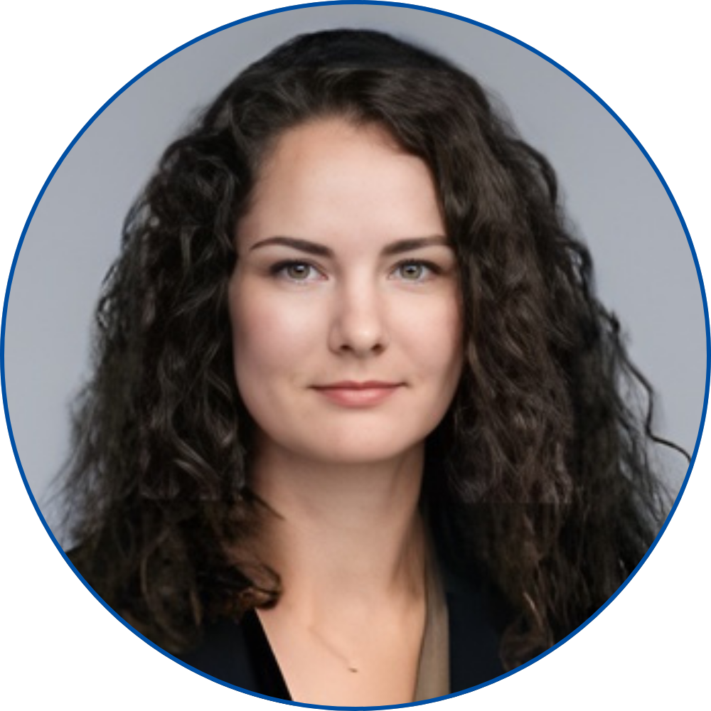
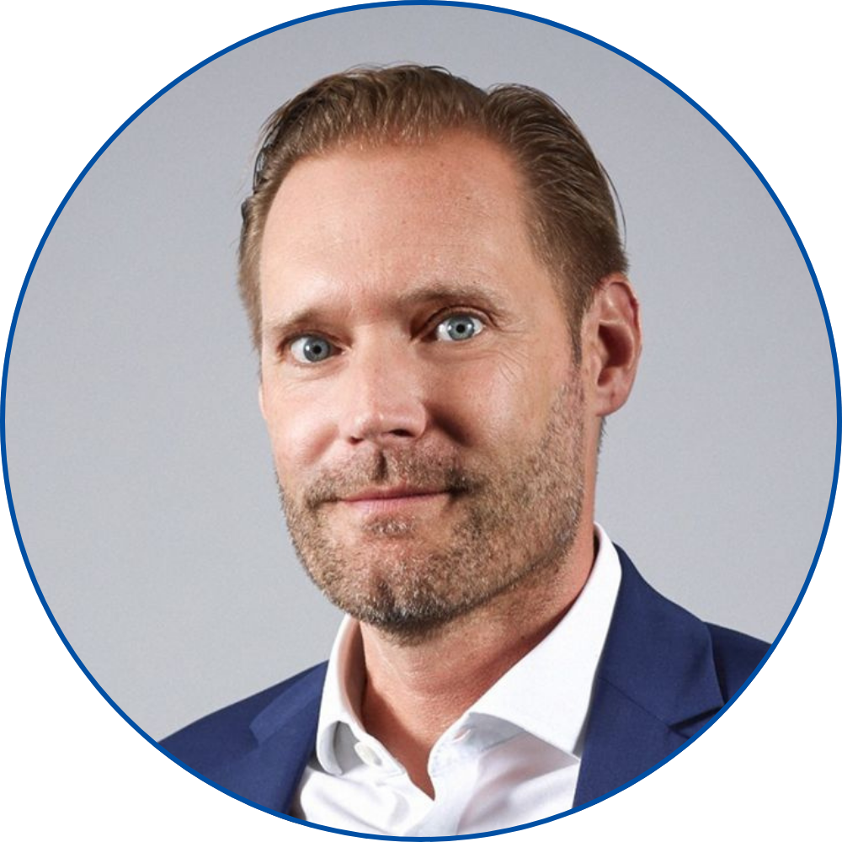
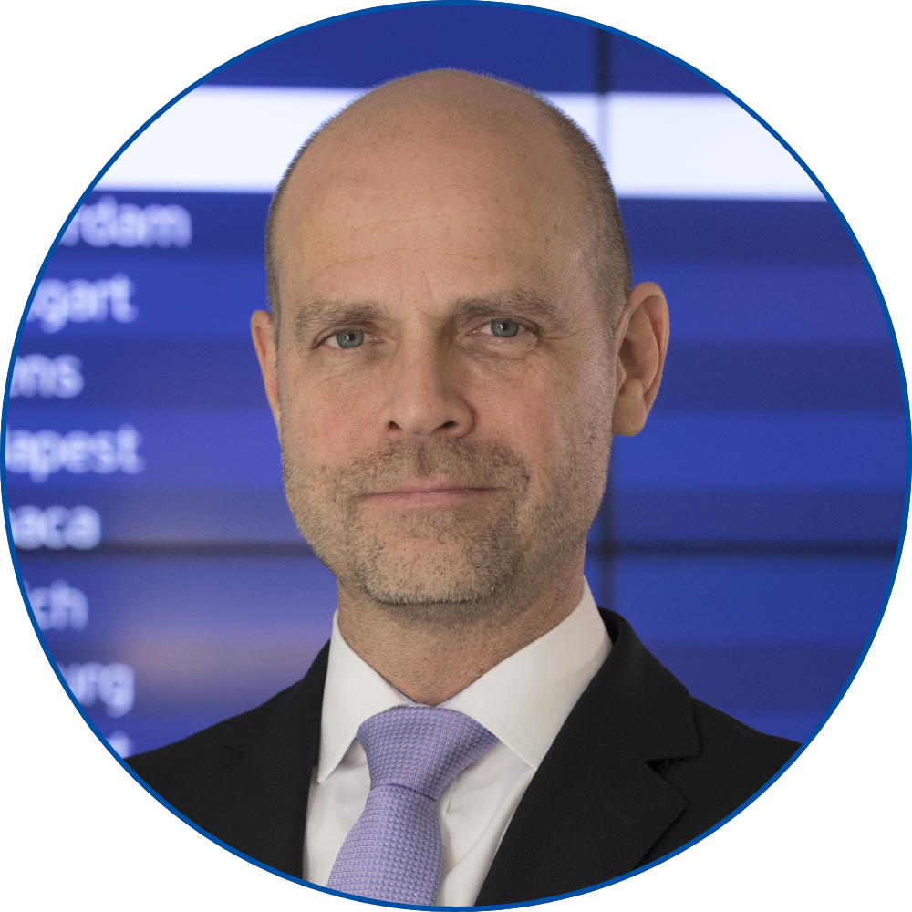
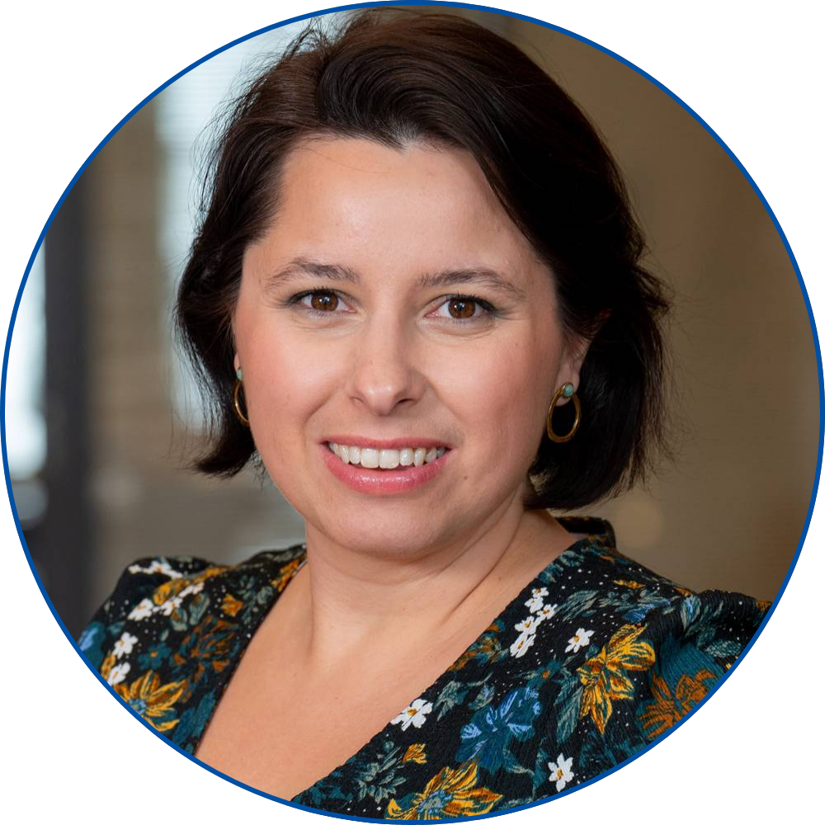
NON-AERO REVENUE GENERATION MASTERCLASS
JAN-HENRIK ANDERSSON
Chief Commercial Officer &
Chief Security Officer
Munich Airport
GINTARE NORVILAITĖ-TAUTEVIČĖ
Chief Commercial Officer
Lithuanian Airports
FLORIAN SEIDEL
Chief Sales Officer
Gebr. Heinemann
ALEXANDER ZINELL
Chief Executive Officer
Fraport Greece
Moderated by
JULIE LASSAIGNE
Secretary General
ETRC

Slide 2
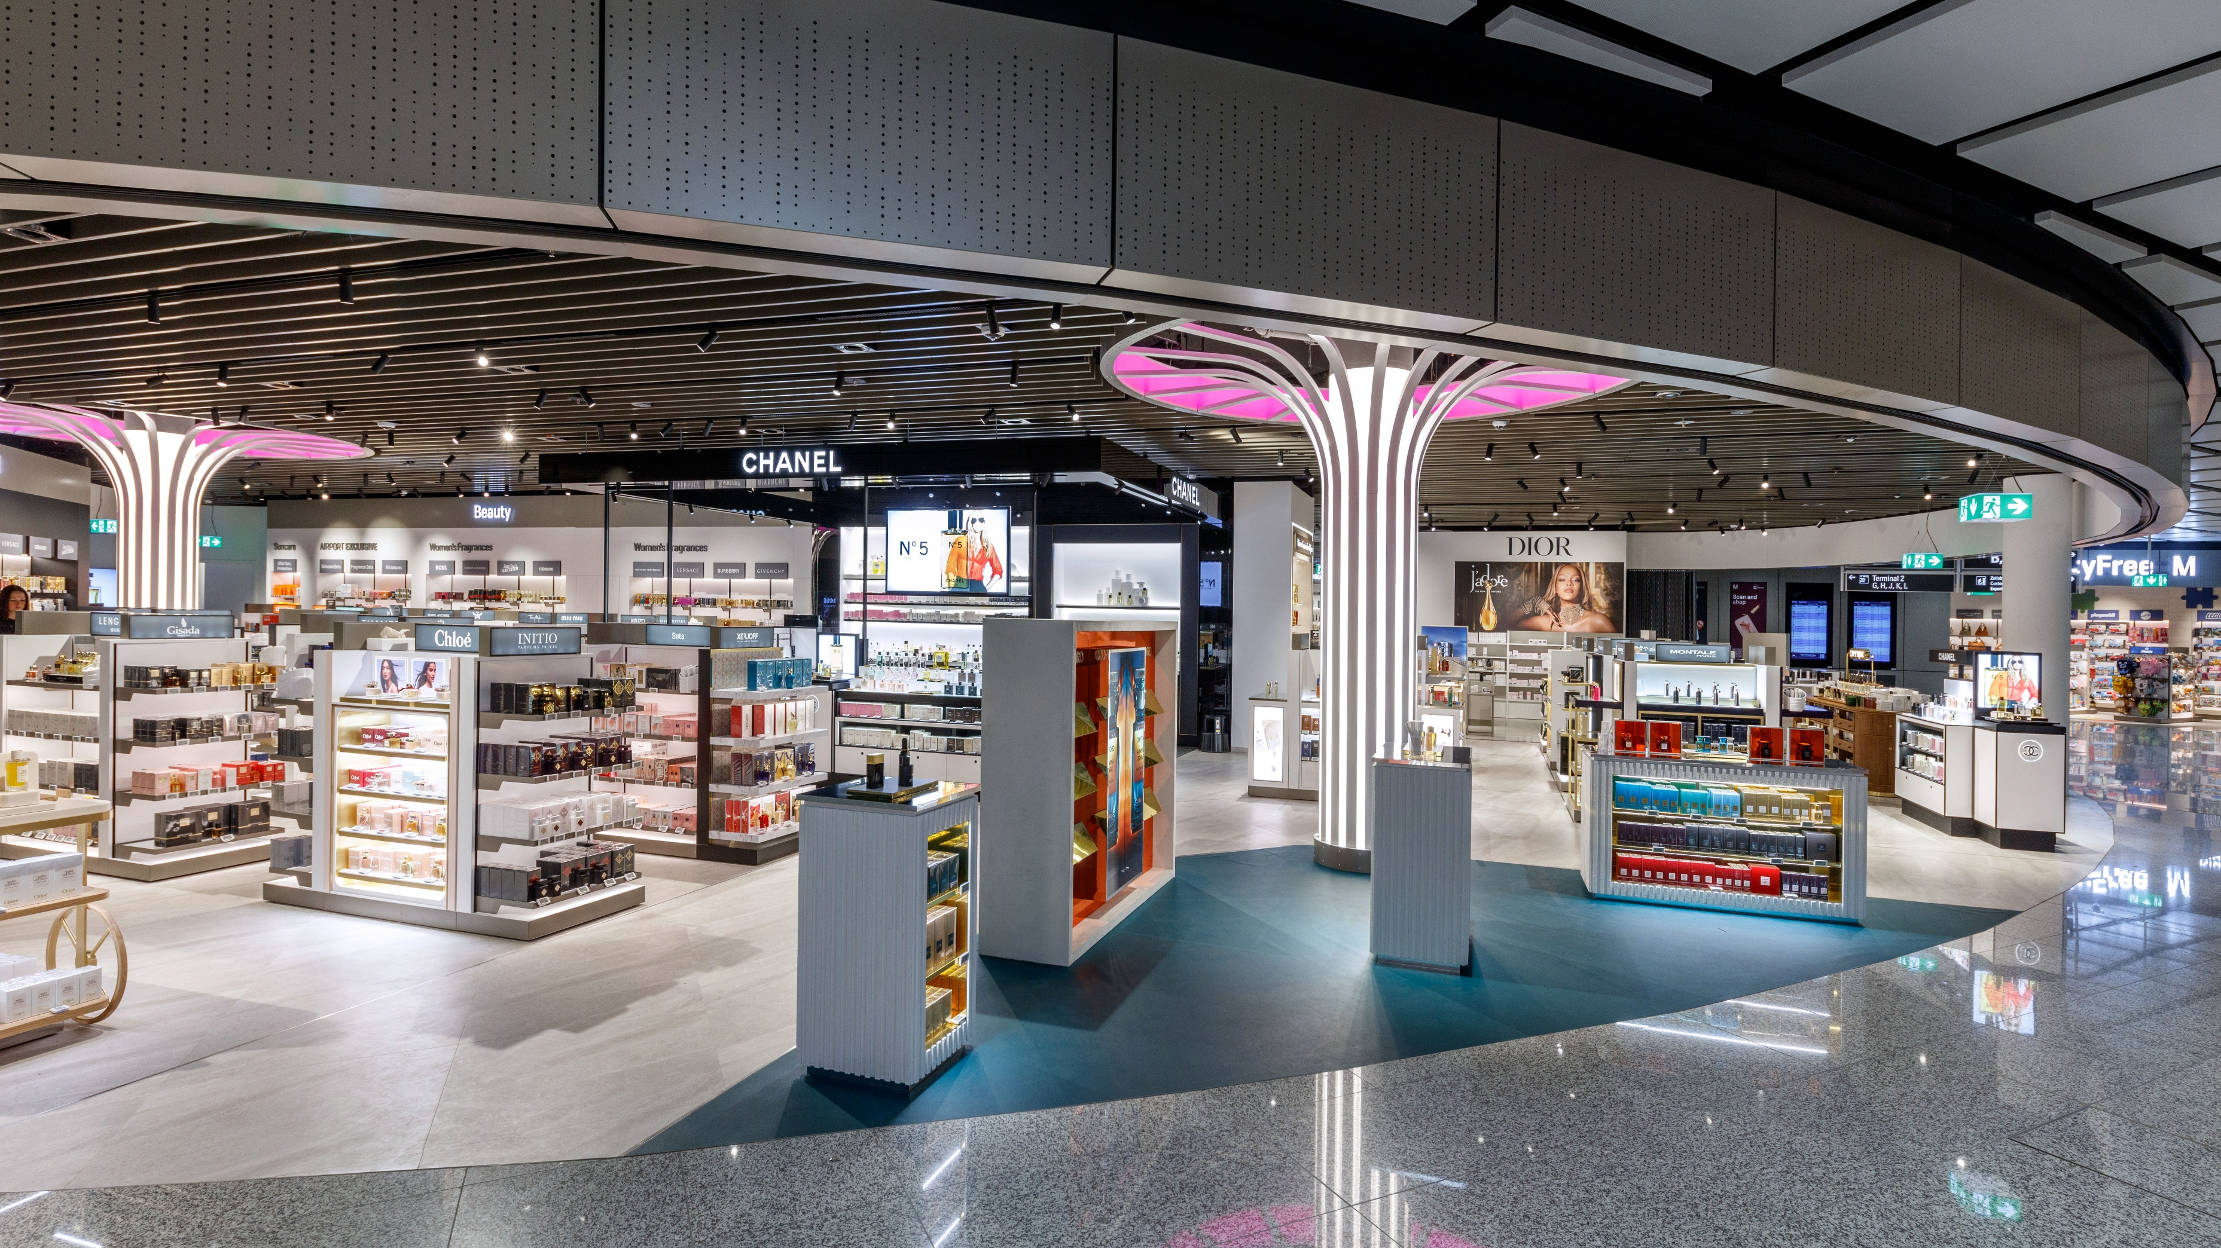
Walk Through Duty Free
T1 PIER
Notes:
Picture for Question 1:
Please show the image when Jan talks about “Recent examples for growing revenues.”

Slide 3
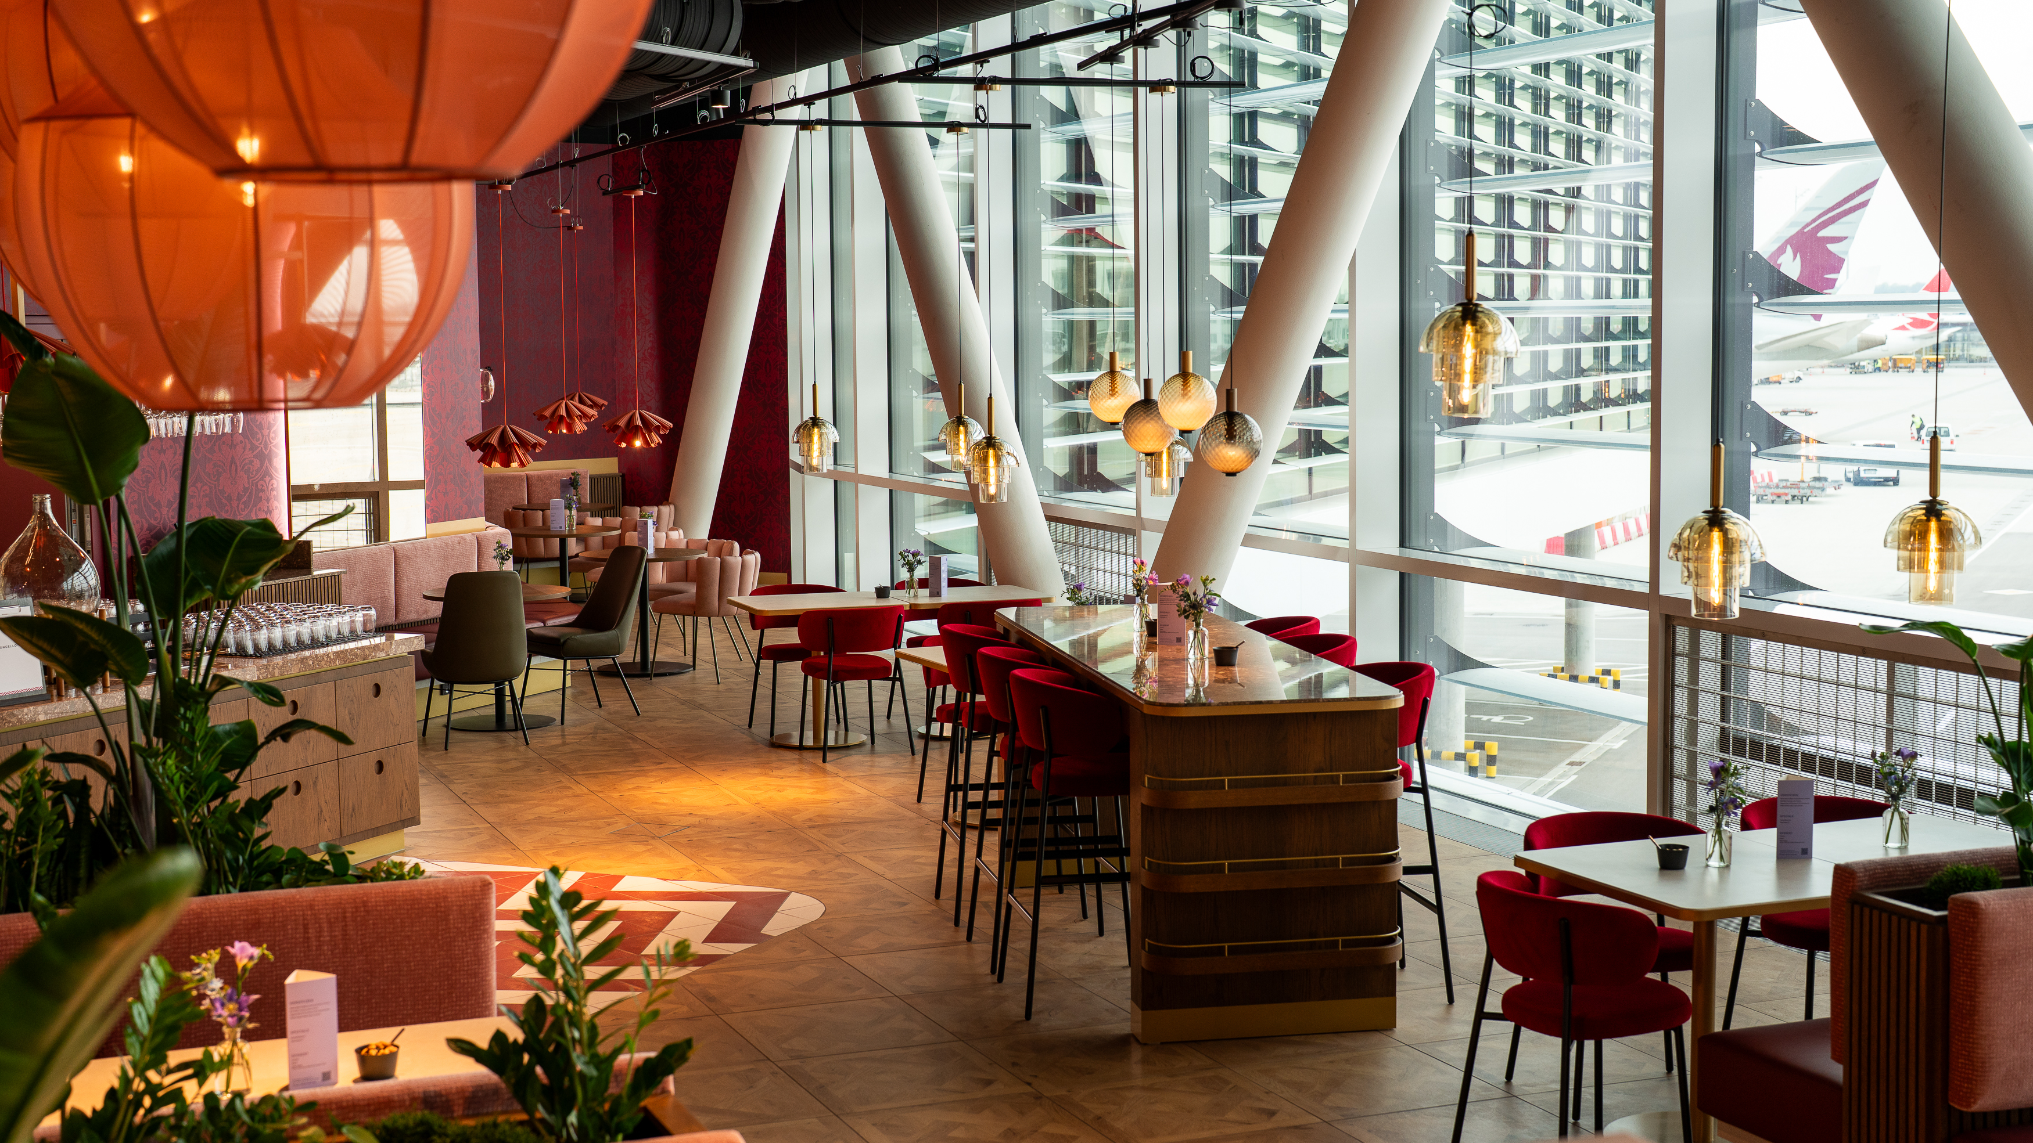
CUCINA POPOLARE
T1 PIER
Notes:
Picture for Question 1:
Please show the image when Jan talks about “Recent examples for growing revenues.”

Slide 4
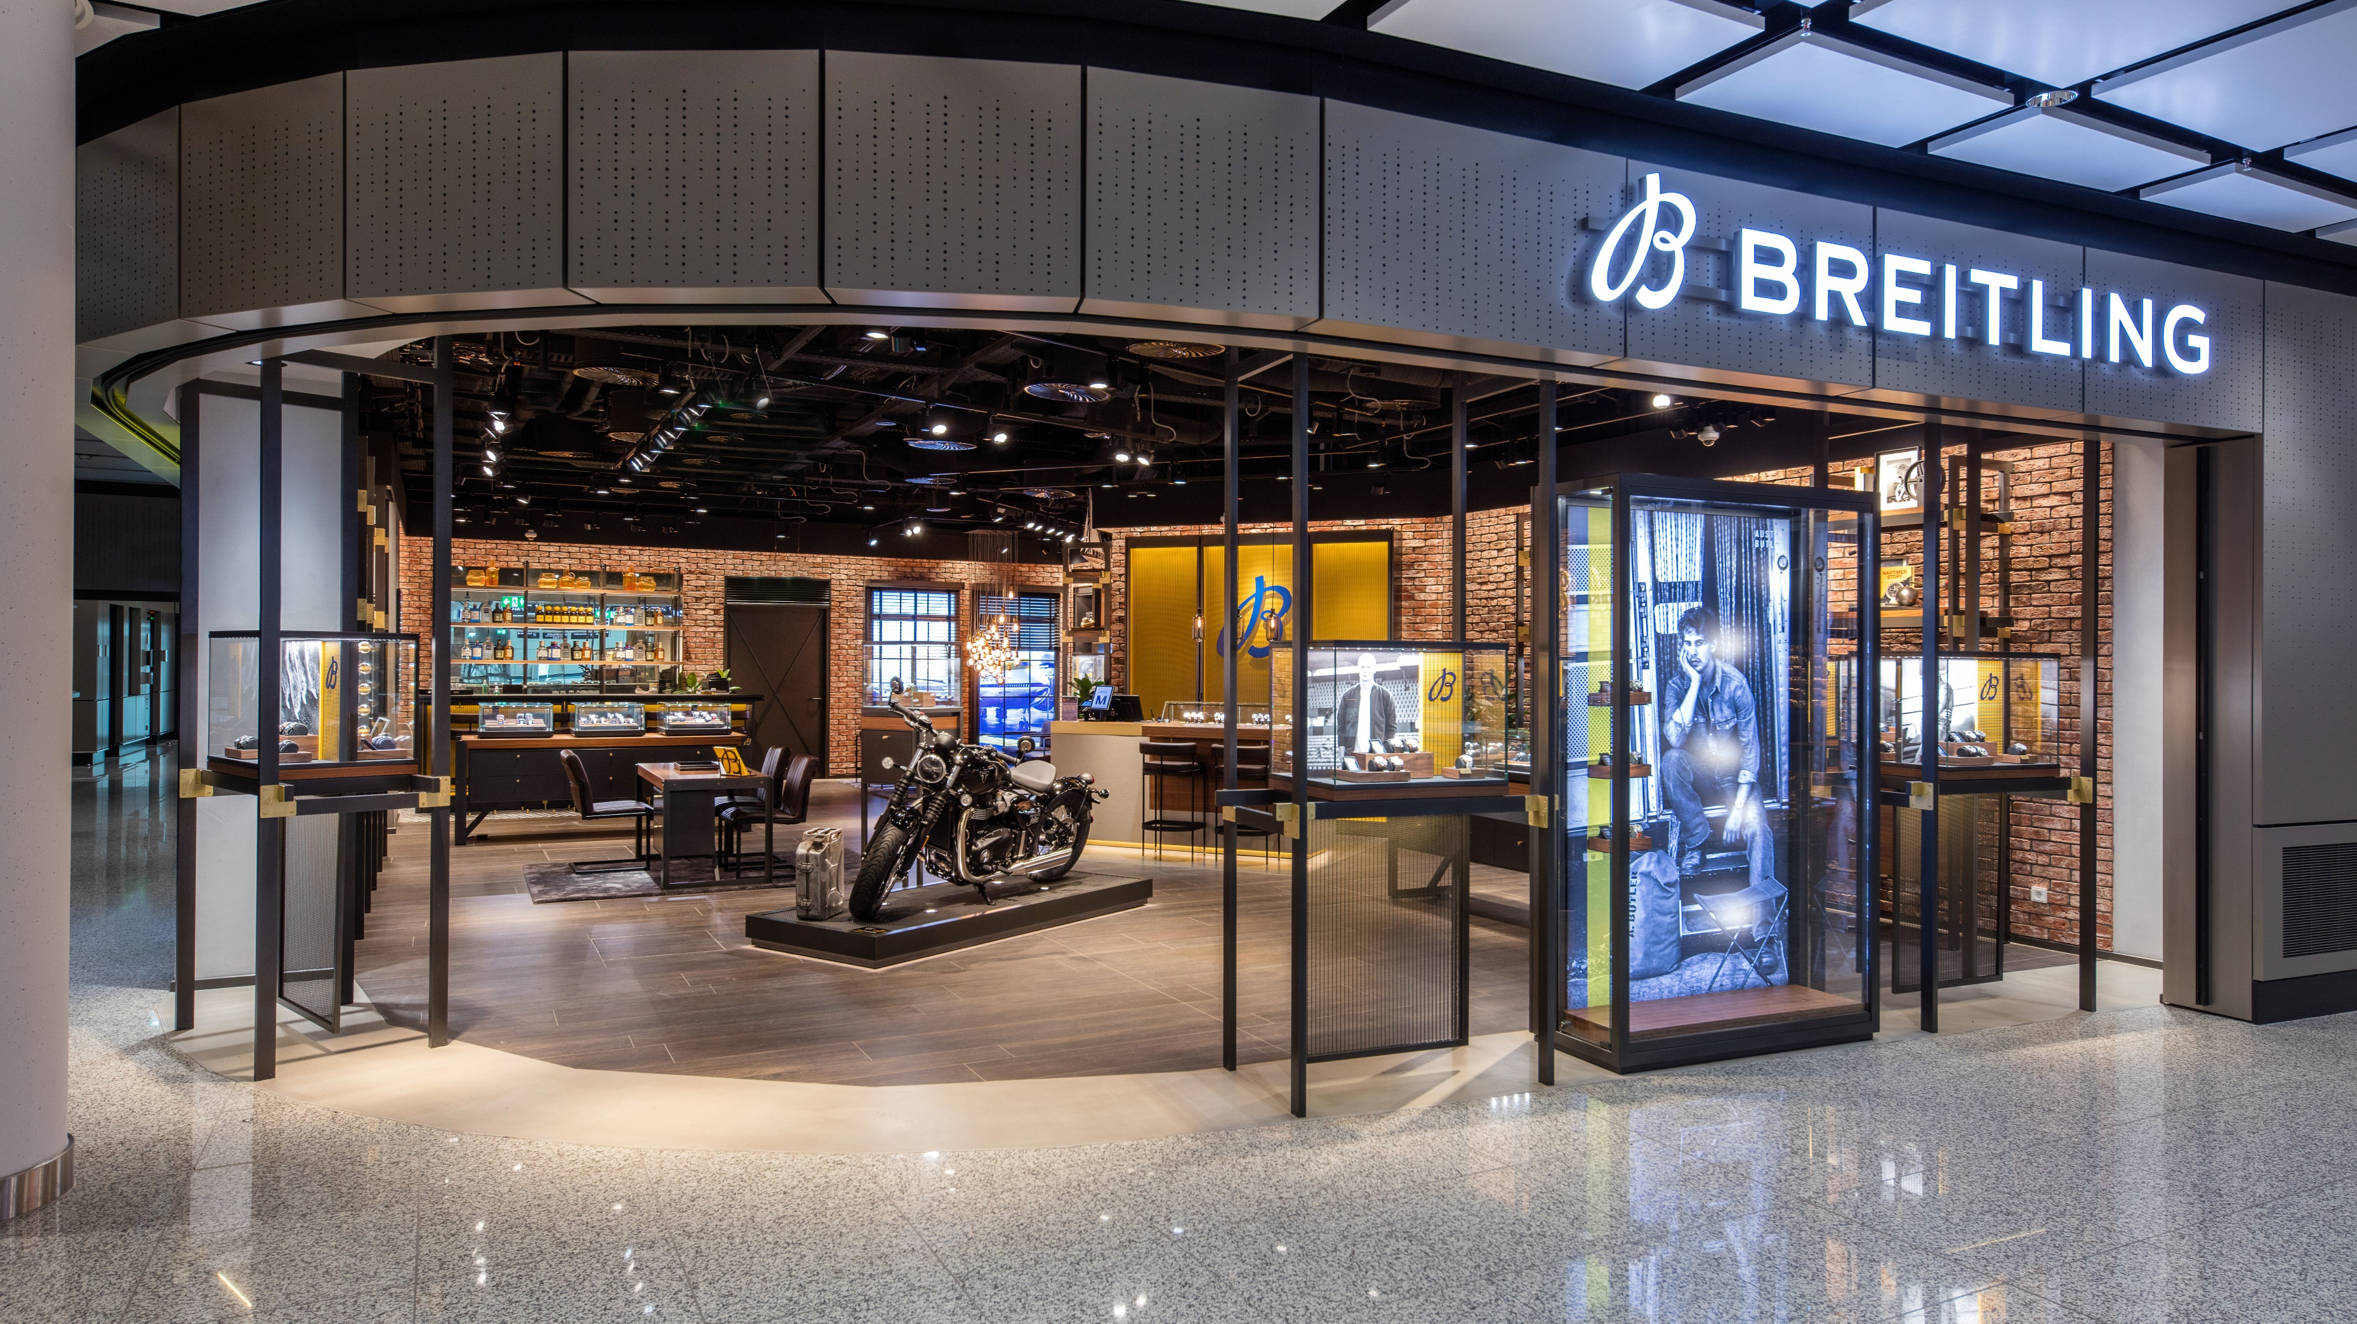
BREITLING STORE
T1 PIER
Notes:
Picture for Question 1:
Please show the image when Jan talks about “Recent examples for growing revenues.”

Slide 5
NON-AERO REVENUE GENERATION MASTERCLASS
JAN-HENRIK ANDERSSON
Chief Commercial Officer &
Chief Security Officer
Munich Airport
GINTARE NORVILAITĖ-TAUTEVIČĖ
Chief Commercial Officer
Lithuanian Airports
FLORIAN SEIDEL
Chief Sales Officer
Gebr. Heinemann
ALEXANDER ZINELL
Chief Executive Officer
Fraport Greece
Moderated by
JULIE LASSAIGNE
Secretary General
ETRC

Slide 6
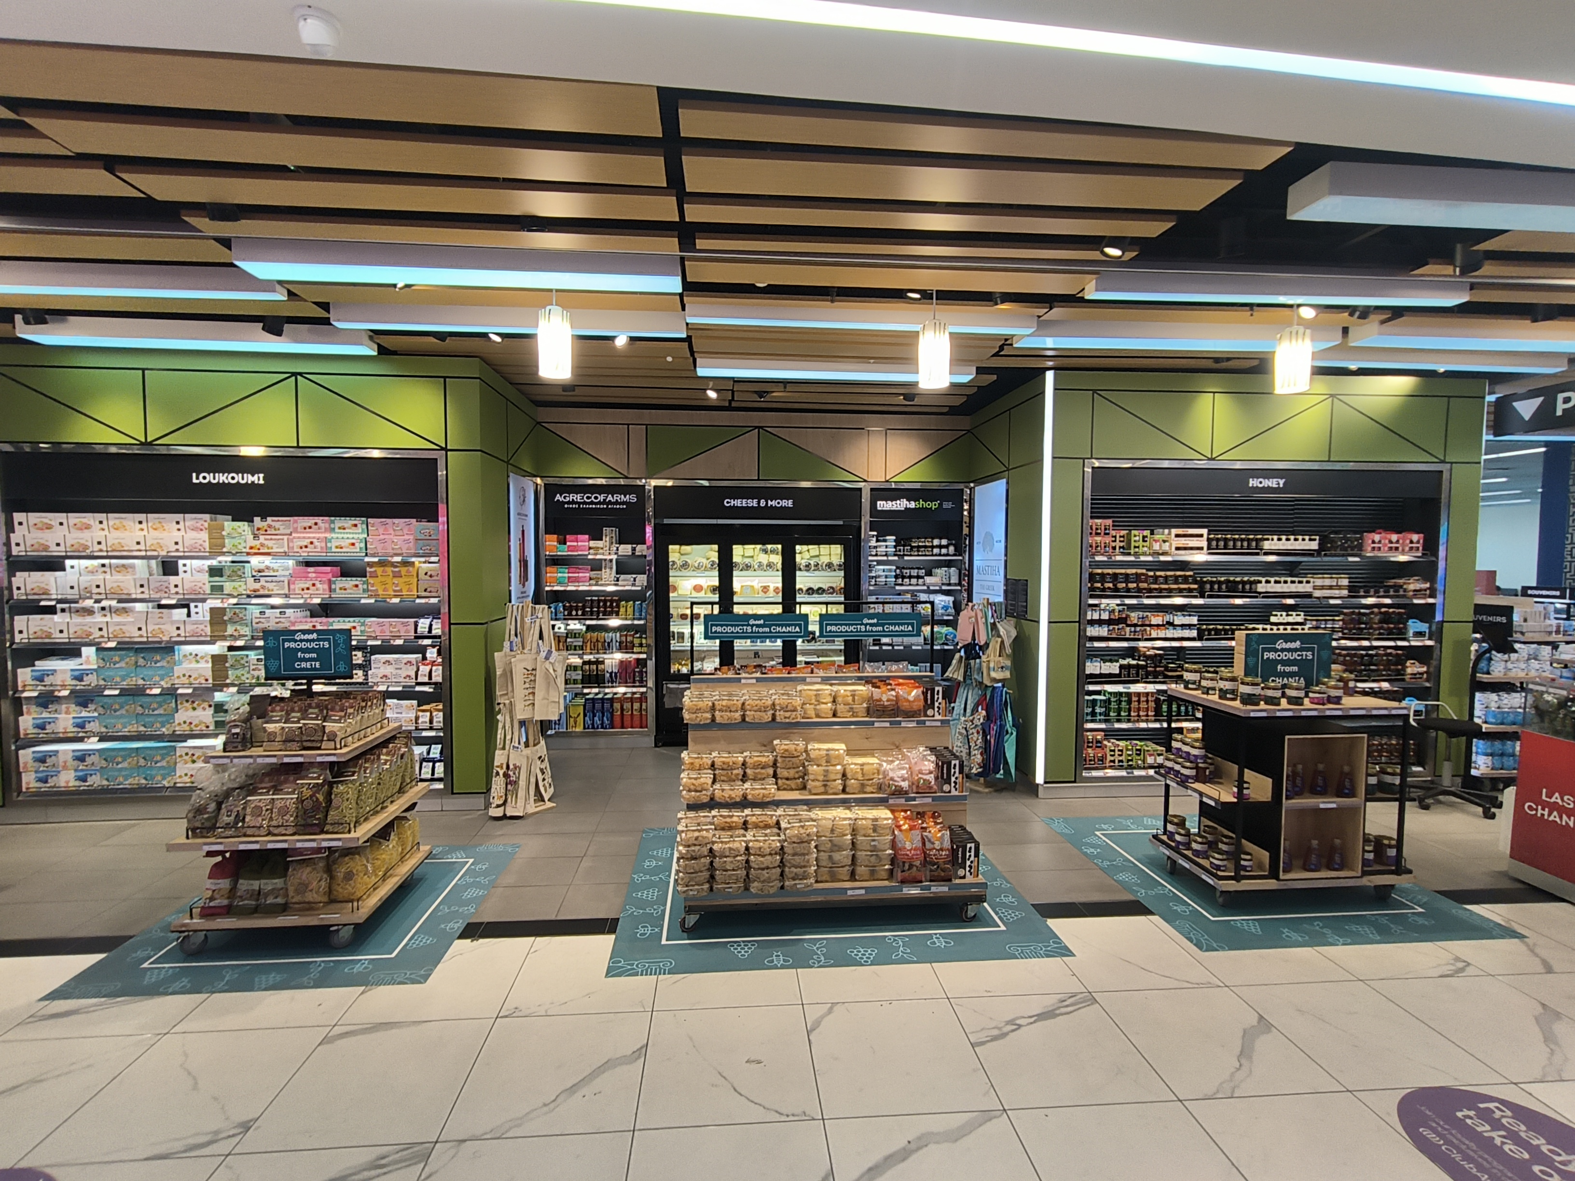
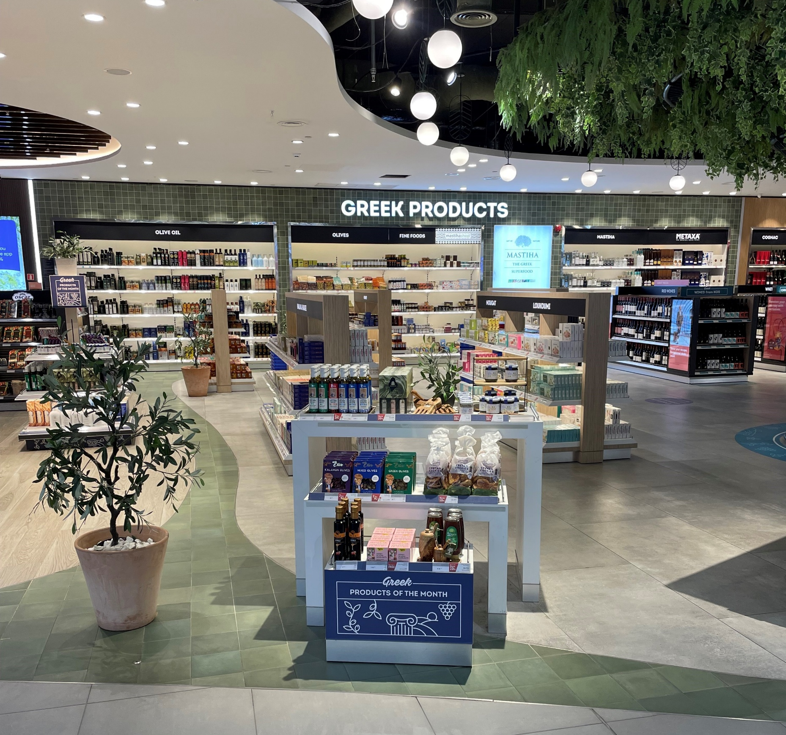
Fraport greece | LOCAL PRODUCTS
CFU
CHQ
KGS

Slide 7
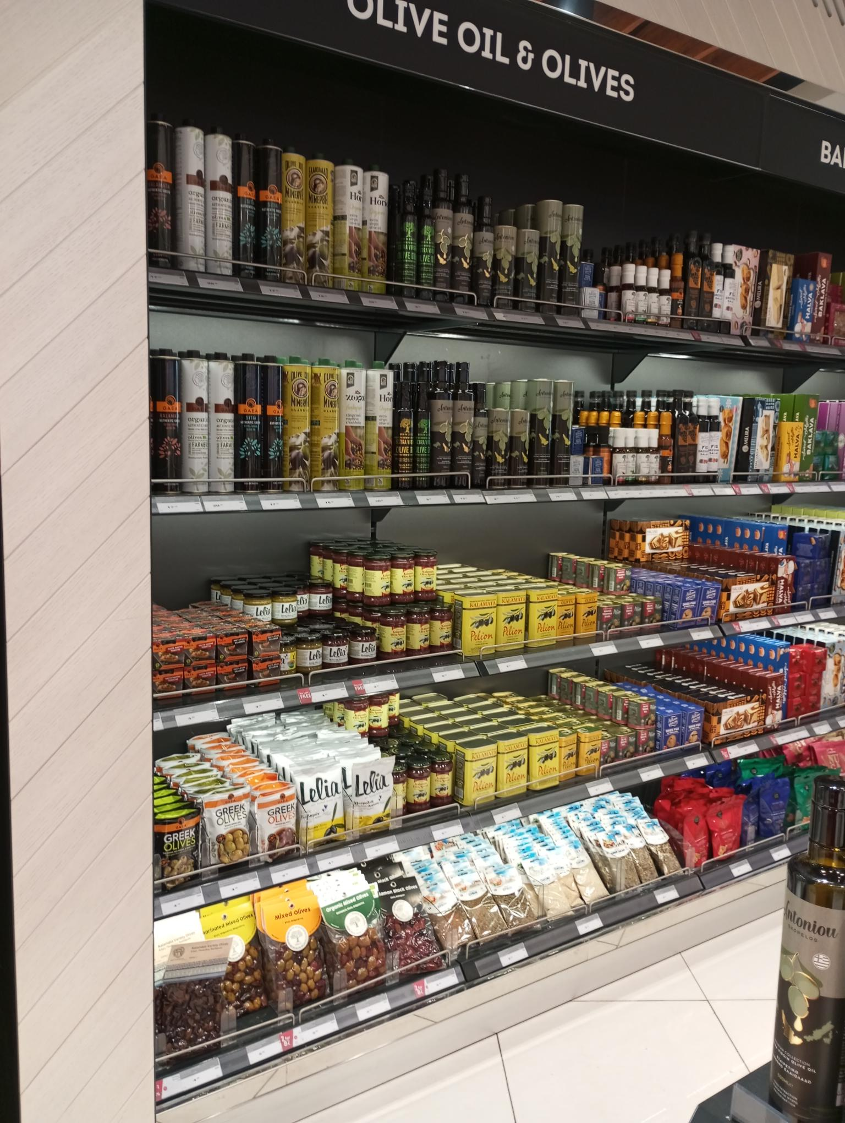
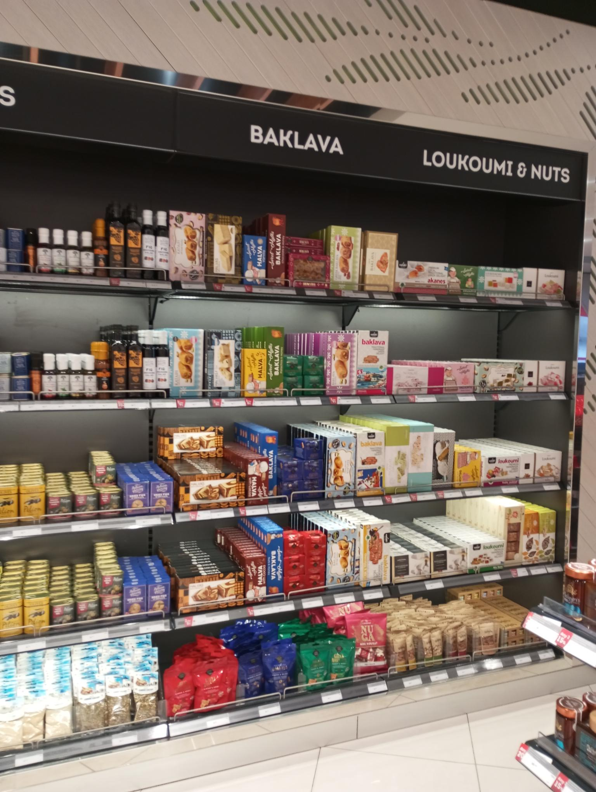
Fraport greece | LOCAL PRODUCTS
JSI
JSI

Slide 8
NON-AERO REVENUE GENERATION MASTERCLASS
JAN-HENRIK ANDERSSON
Chief Commercial Officer &
Chief Security Officer
Munich Airport
GINTARE NORVILAITĖ-TAUTEVIČĖ
Chief Commercial Officer
Lithuanian Airports
FLORIAN SEIDEL
Chief Sales Officer
Gebr. Heinemann
ALEXANDER ZINELL
Chief Executive Officer
Fraport Greece
Moderated by
JULIE LASSAIGNE
Secretary General
ETRC

Slide 9
VIKTUALIENMARKT
T2 SATELLITE
Notes:
Picture for Question 6:
Please show the image when Jan talks about “Liveable traditions”

Slide 10
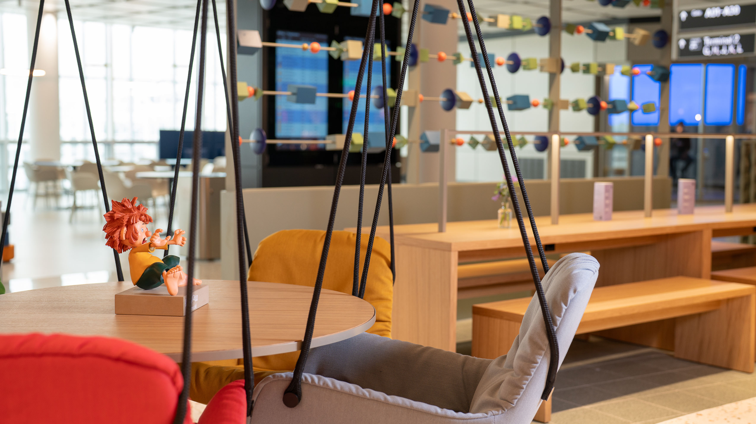
LEIBSPEISE
T1 PIER
Notes:
Picture for Question 6:
Please show the image when Jan talks about “Passenger journey within Sense-of-Place T1 Pier”

Slide 11
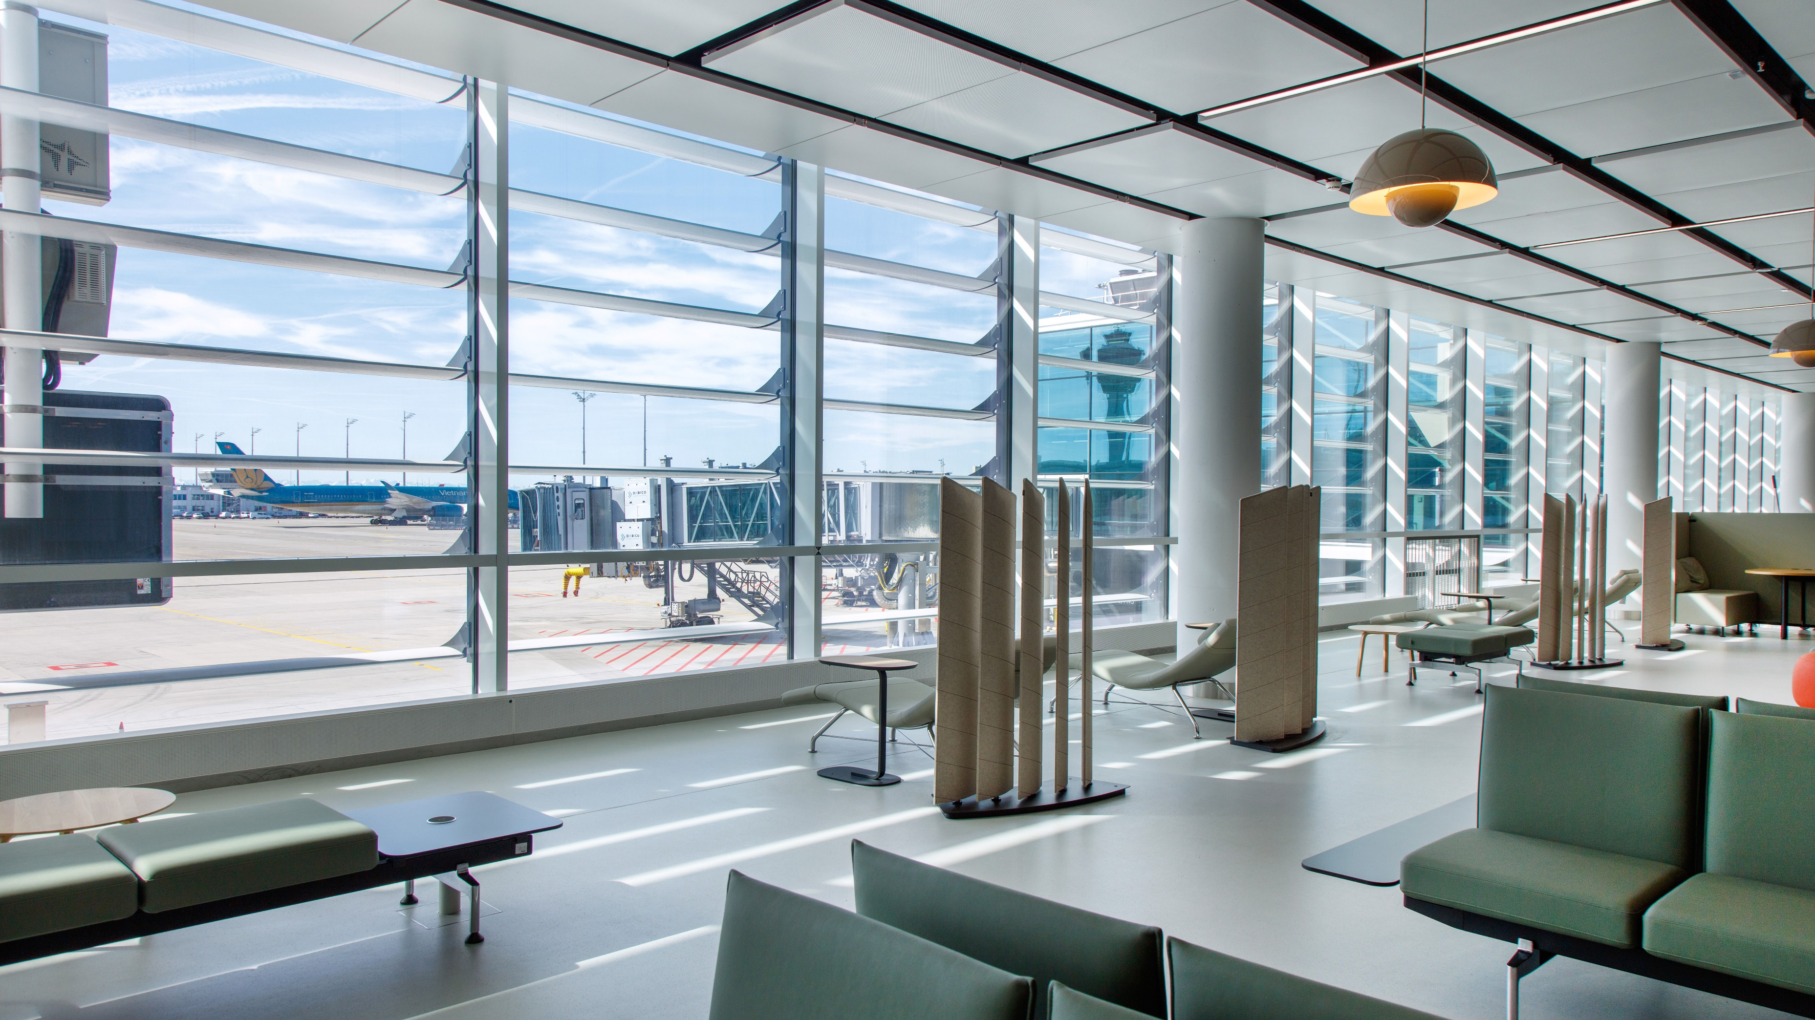
RECREATION AREA
T1 PIER
Notes:
Picture for Question 6:
Please show the image when Jan talks about “Passenger journey within Sense-of-Place T1 Pier”

Slide 12
NON-AERO REVENUE GENERATION MASTERCLASS
JAN-HENRIK ANDERSSON
Chief Commercial Officer &
Chief Security Officer
Munich Airport
GINTARE NORVILAITĖ-TAUTEVIČĖ
Chief Commercial Officer
Lithuanian Airports
FLORIAN SEIDEL
Chief Sales Officer
Gebr. Heinemann
ALEXANDER ZINELL
Chief Executive Officer
Fraport Greece
Moderated by
JULIE LASSAIGNE
Secretary General
ETRC

Slide 13
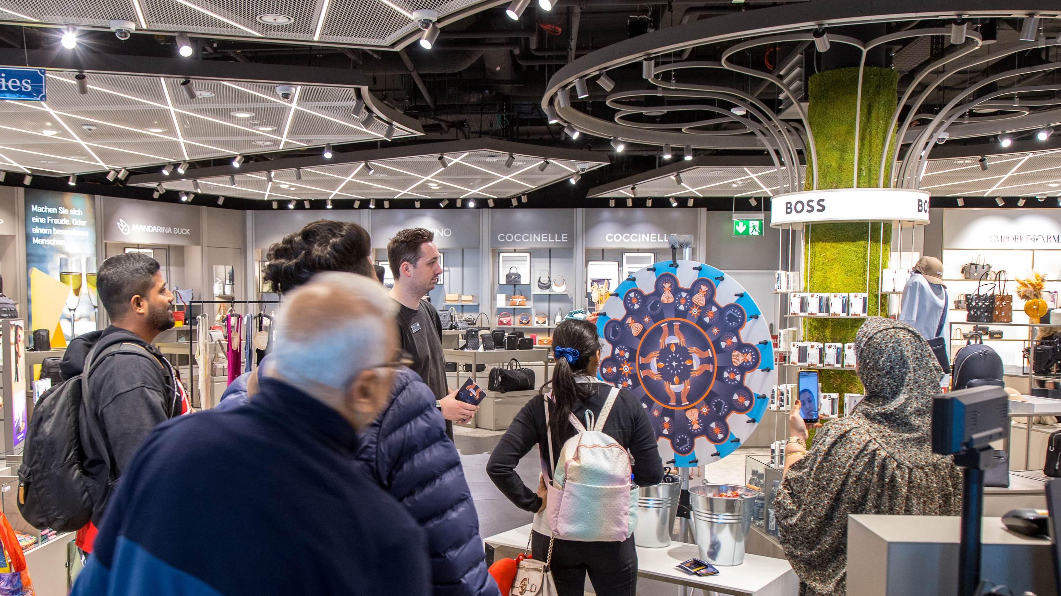
DIWALI PROMOTION
Notes:
Picture for Question 8:
Please show the image when Jan talks about “From waiting time to experience time”

Slide 14
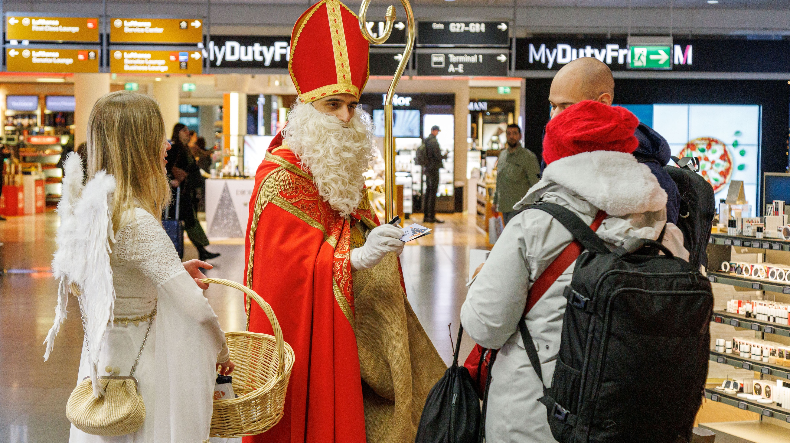
SANTA CLAUSE IN TERMINAL2
Notes:
Picture for Question 8:
Please show the image when Jan talks about “Seasonal & cultural highlights (Christmas)”

Slide 15
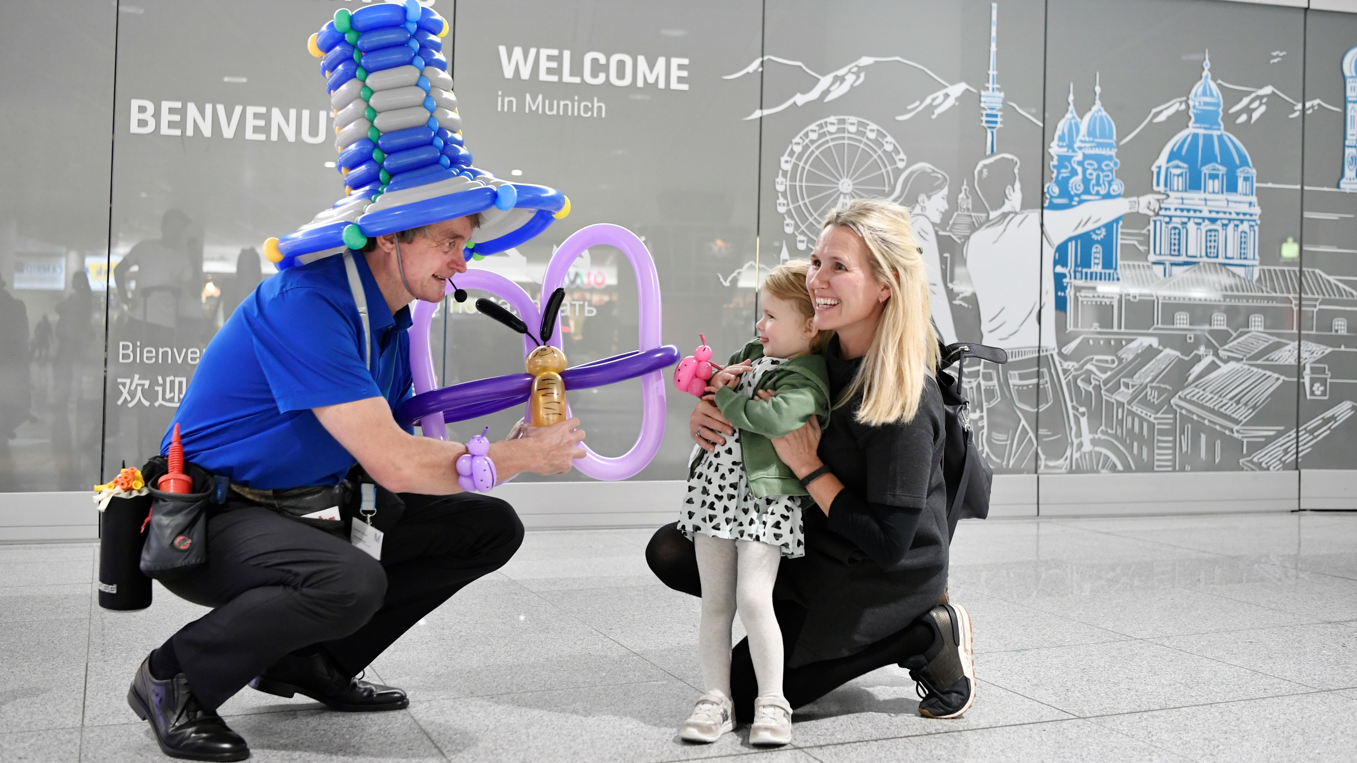
MAGICIAN IN TERMINAL 2
Notes:
Picture for Question 8:
Please show the image when Jan talks about “surprise & delight”

Slide 16
NON-AERO REVENUE GENERATION MASTERCLASS
JAN-HENRIK ANDERSSON
Chief Commercial Officer &
Chief Security Officer
Munich Airport
GINTARE NORVILAITĖ-TAUTEVIČĖ
Chief Commercial Officer
Lithuanian Airports
FLORIAN SEIDEL
Chief Sales Officer
Gebr. Heinemann
ALEXANDER ZINELL
Chief Executive Officer
Fraport Greece
Moderated by
JULIE LASSAIGNE
Secretary General
ETRC

Slide 17
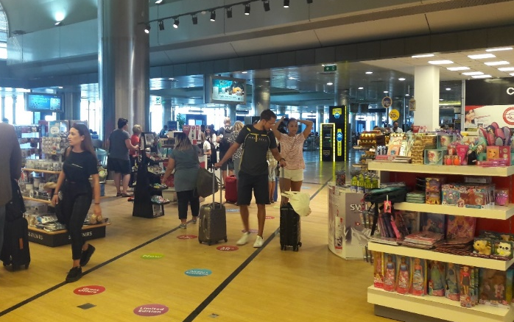
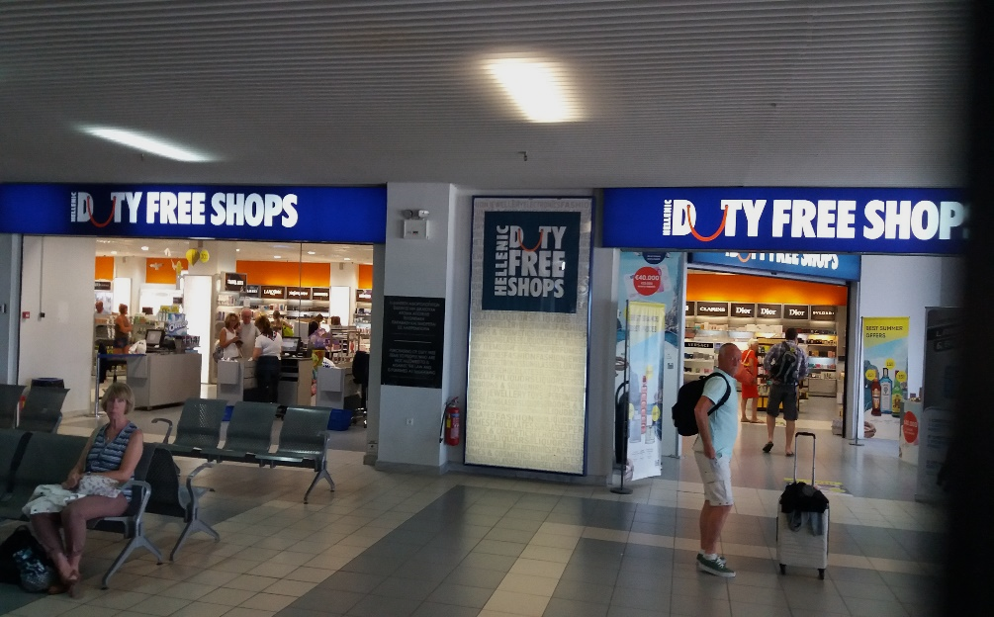
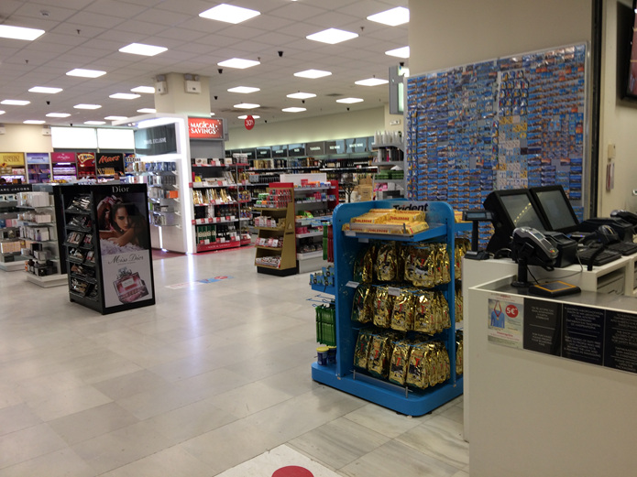
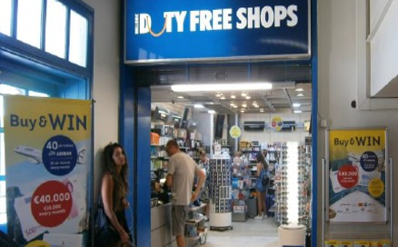
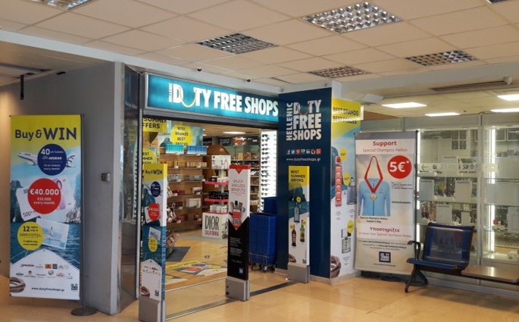
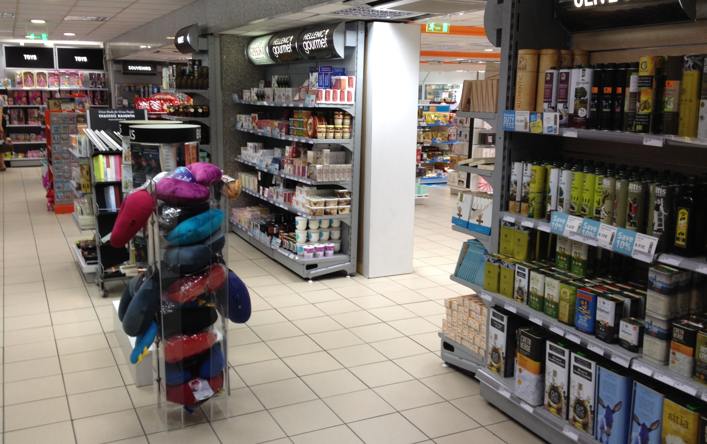
Fraport greece | Retail Areas
Before CCD
SKG
ZTH
CHQ
JTR
KGS
RHO

Slide 18
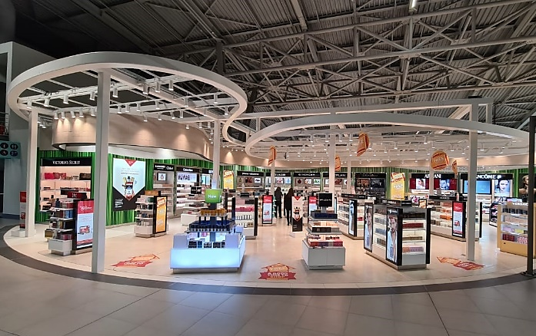
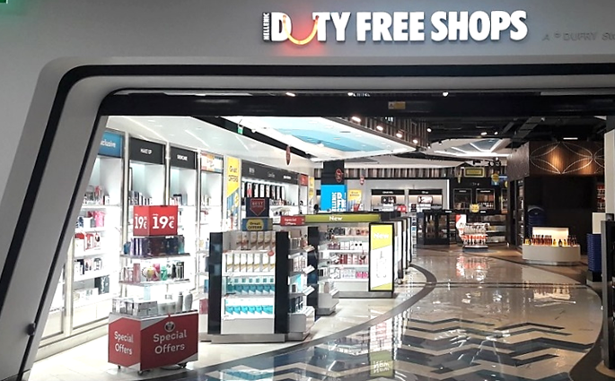
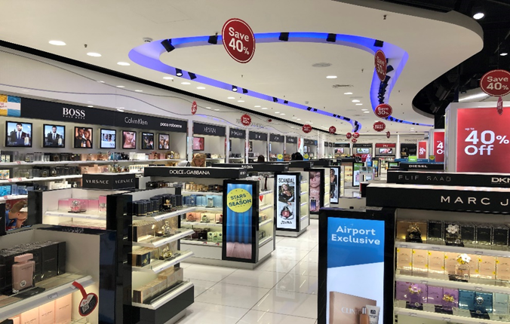
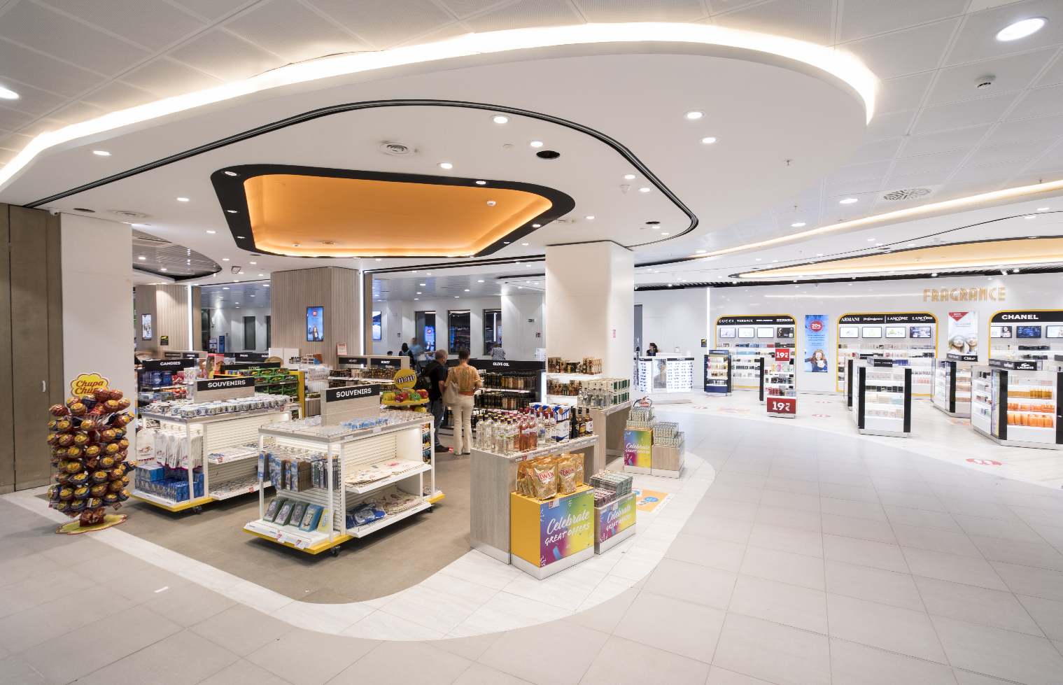
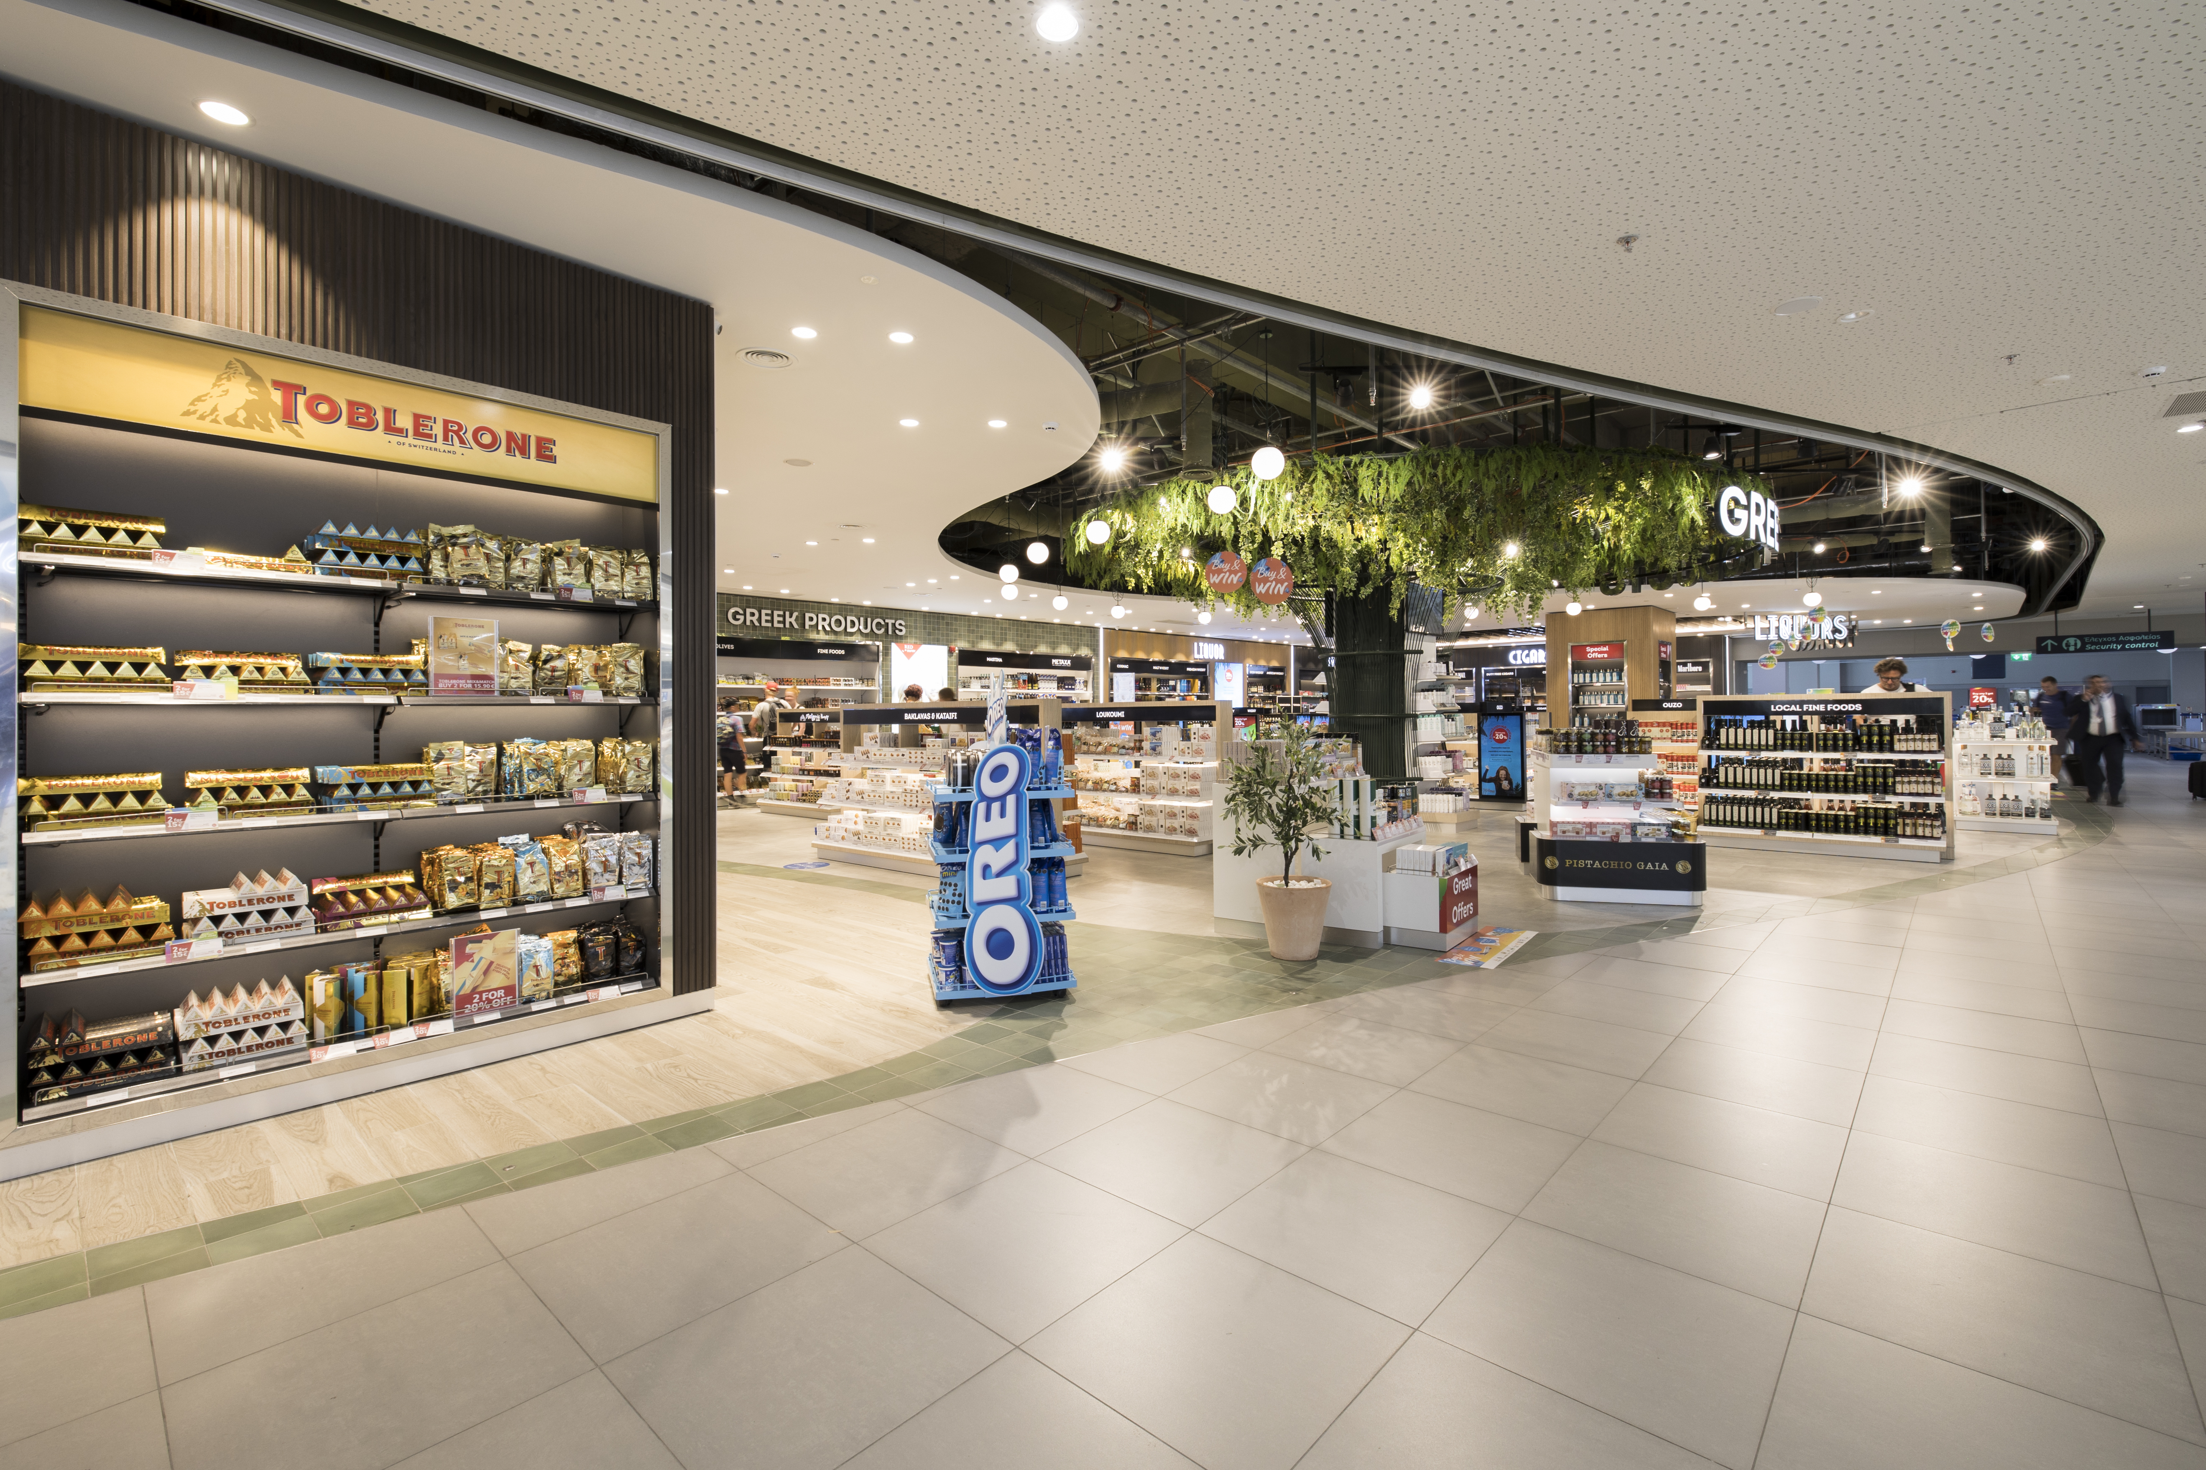
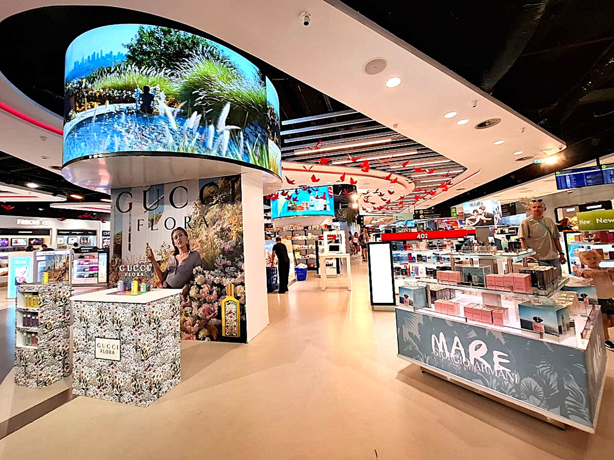
Fraport greece | Newly Developed Retail Areas
SKG
ZTH
CHQ
JTR
KGS
RHO

Slide 19
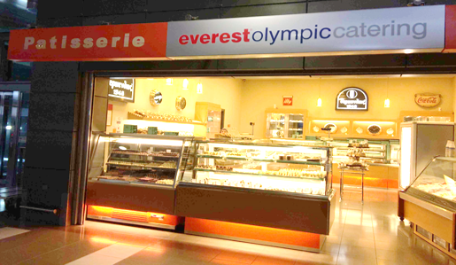
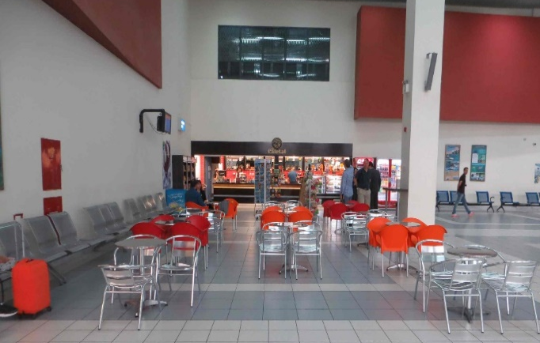
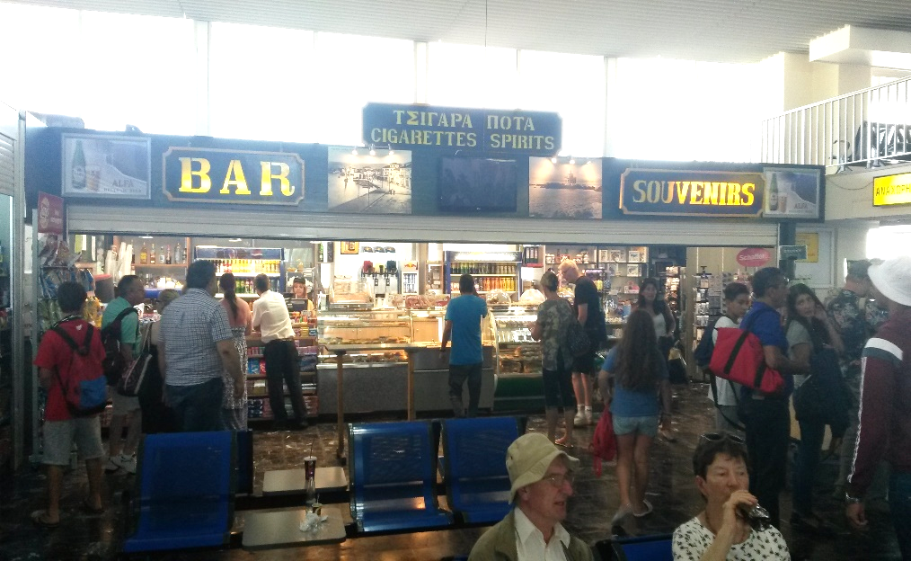
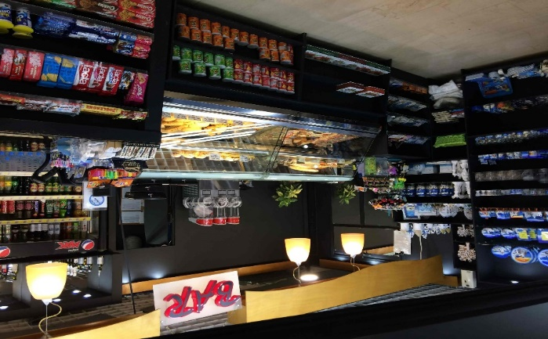
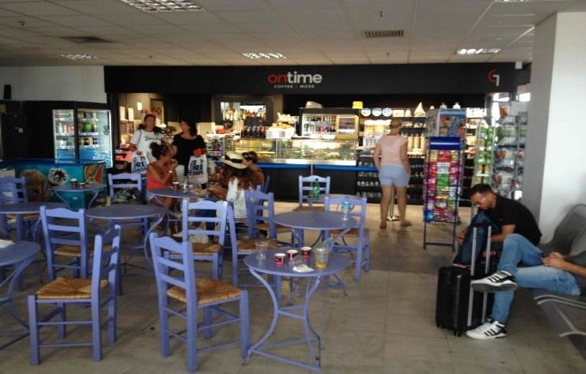
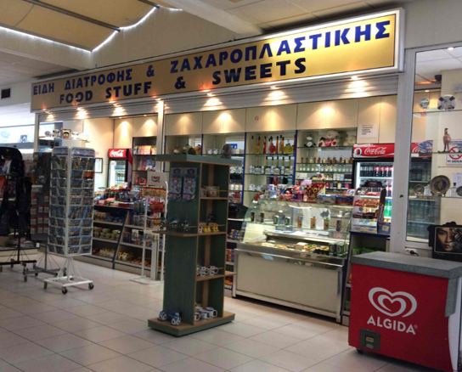
Fraport greece | Food & Beverage Units
Before CCD
SKG
ZTH
EFL
JTR
JMK
RHO

Slide 20
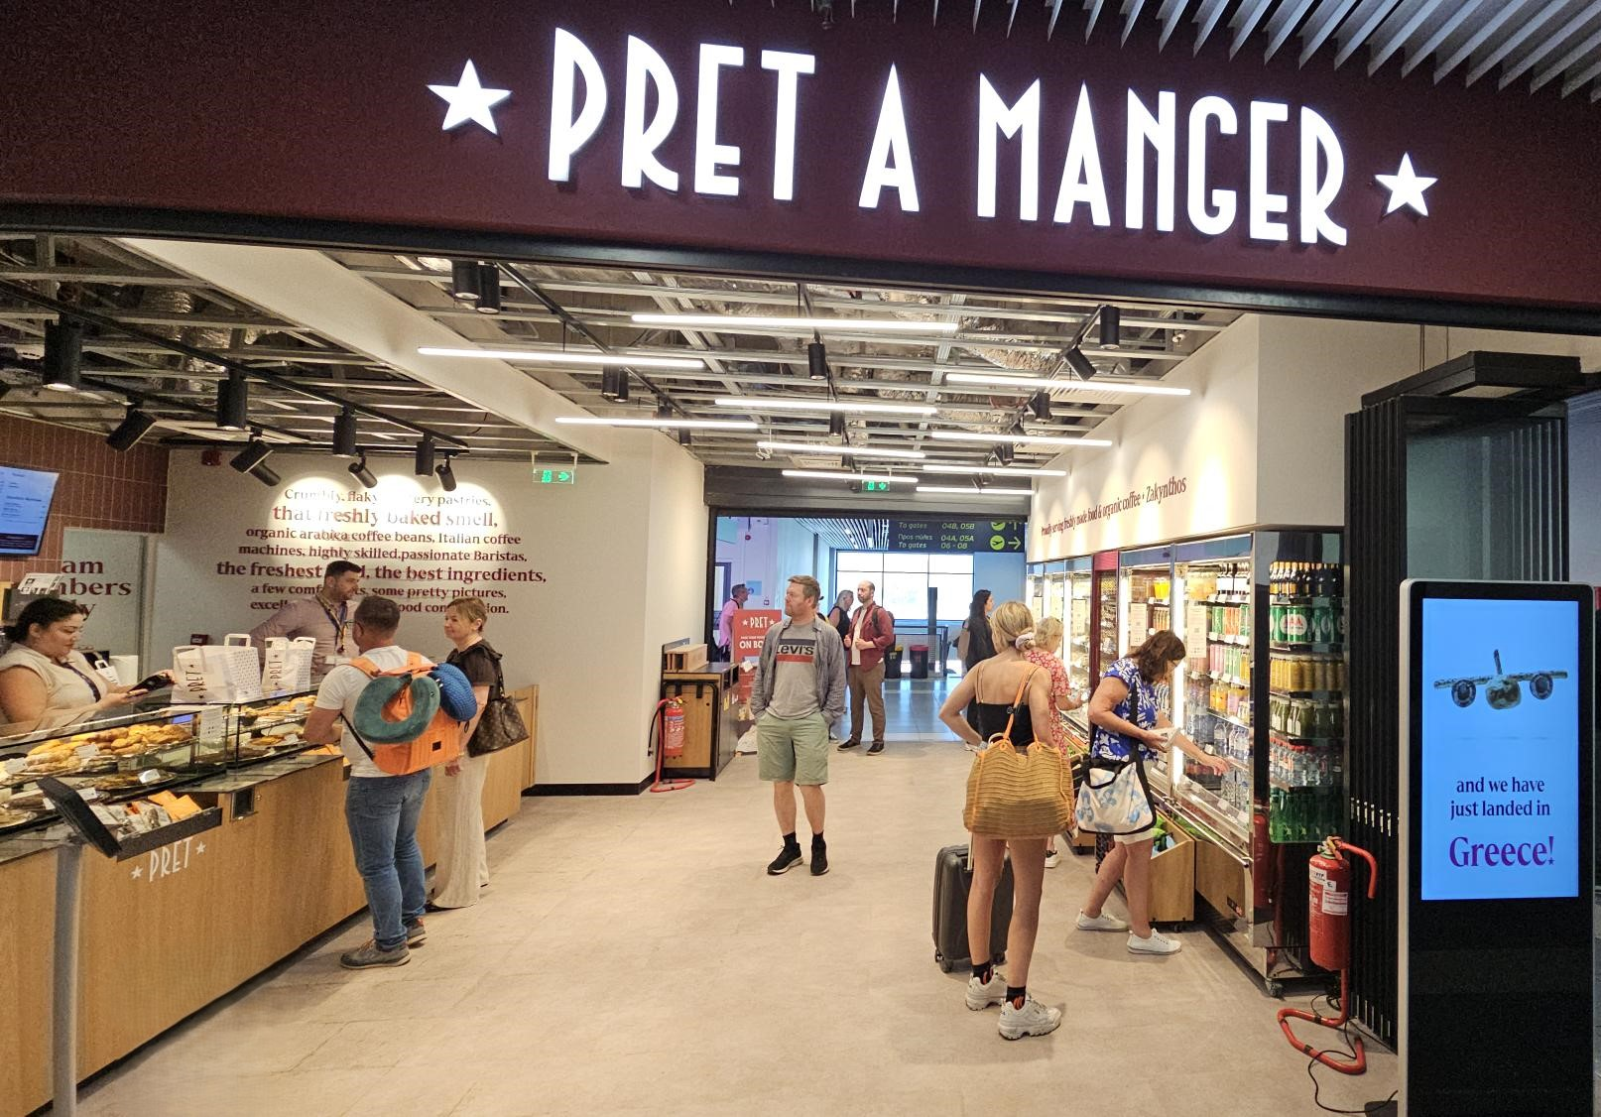
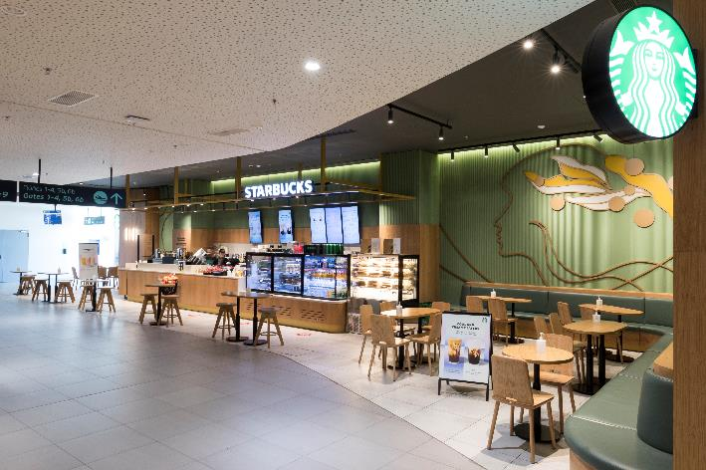
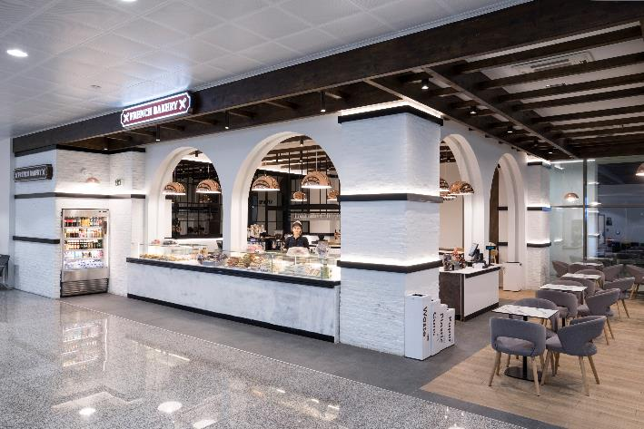
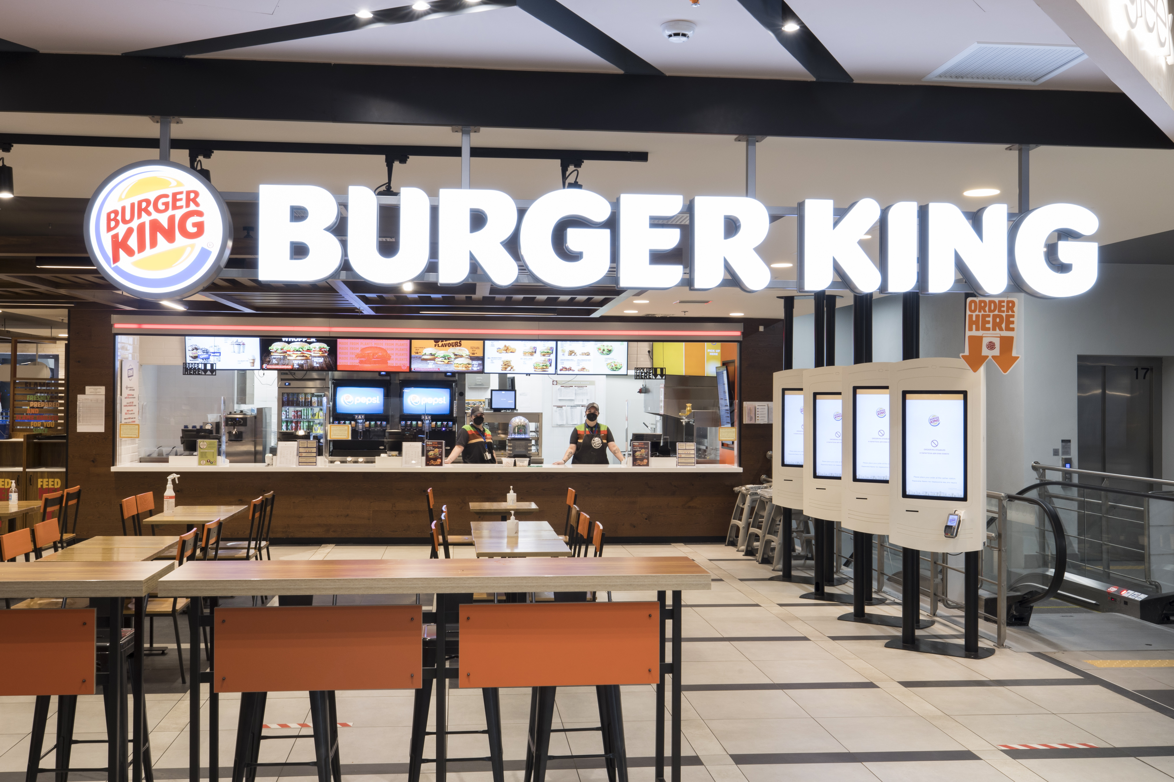
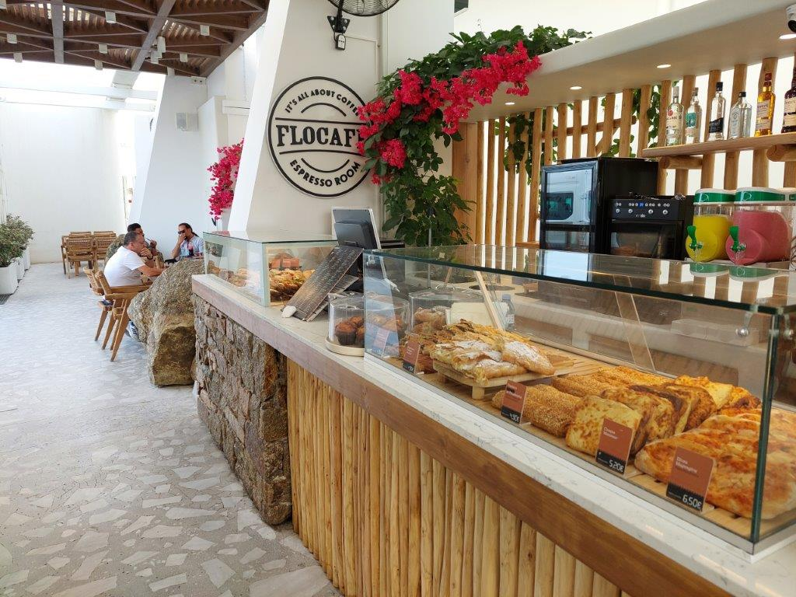
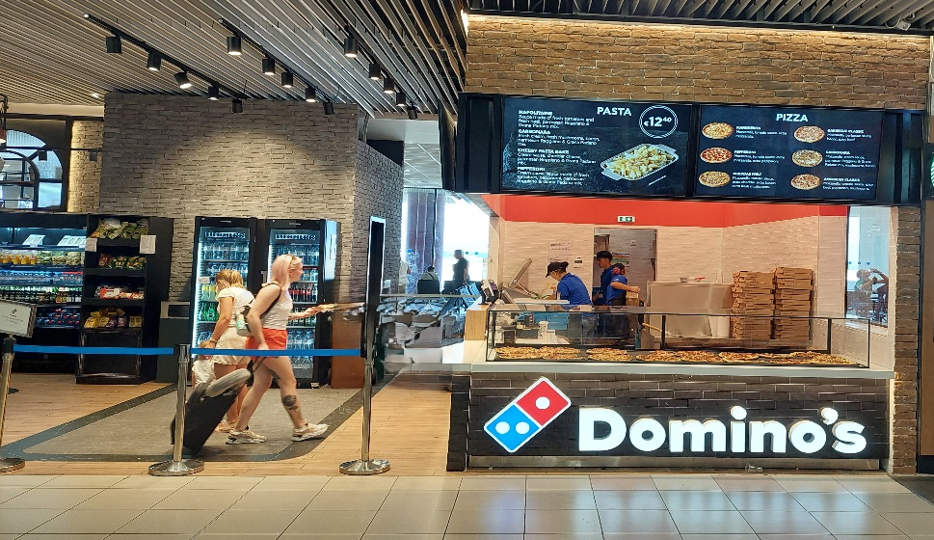
Fraport greece | Newly Developed Food & Beverage Areas
ZTH
KGS
JTR
CFU
JMK
RHO

Slide 21
NON-AERO REVENUE GENERATION MASTERCLASS
JAN-HENRIK ANDERSSON
Chief Commercial Officer &
Chief Security Officer
Munich Airport
GINTARE NORVILAITĖ-TAUTEVIČĖ
Chief Commercial Officer
Lithuanian Airports
FLORIAN SEIDEL
Chief Sales Officer
Gebr. Heinemann
ALEXANDER ZINELL
Chief Executive Officer
Fraport Greece
Moderated by
JULIE LASSAIGNE
Secretary General
ETRC

